Slide 1
«Оценка безопасности биоаналогов: реалии сегодняшнего дня»
С.К. Зырянов
Профессор кафедры клинической фармакологии РНИМУ им. Н.И. Пирогова
(г. Москва, Россия)

Slide 2
Основные определения
Биологическое лекарственное средство
Лекарственное средство, активной субстанцией которого является биологическое вещество, полученное или выделенное из биологического источника, в том числе при помощи одного или нескольких перечисленных биотехнологических методов: технология рекомбинантной ДНК; контролируемая экспрессия генов, кодирующих выработку биологически активных белков; методы гибридом и моноклональных антител

Slide 3
Ситуация с биоаналогами в ЕС: 16 одобрены; 2 аннулированы; 6 отозваны
Biosimilar Trade Name | Product Type | Company | Reference Product | Decision
Alpheon® | Interferon alfa-2a | BioPartners | Roferon-A® | Rejected (2006): High incidence of relapse/AEs; non validated immunogenicity assays; impurities
Omnitrope® Valtropin® | Somatropin | Sandoz BioPartners | Genotropin® Humatrope® | Approved (2006) Approved (2006); Withdrawn (2012): Commercial reasons
Binocrit® Epoetin alpha Hexal® Abseamed® Epostim® | Epoetin alfa (EPO) | Sandoz Hexal Medice Reliance GeneMedix | Eprex® | Approved (2007) Withdrew application (2011): Inability to fulfill CHMP’s request for additional data within timeframe allowed
Retacrit® Silapo® | Epoetin zeta (EPO) | Hospira Stada | Eprex® | Approved (2007)
Biograstim® Ratiograstim® Tevagrastim® Filgrastim Ratiopharm® Filgrastim Hexal® Zarzio® Nivestim® | Filgrastim (G-CSF) | CT Arzneimittel Ratiopharm Teva Ratiopharm Hexal Sandoz Hospira | Neupogen® | Approved (2008) Approved (2008); Withdrawn (2011): Commercial reasons Approved (2009) Approved (2010)
Biferonex® | Interferon beta-1a | BioPartners | Avonex® | Rejected (2009): Lack of efficacy; differences with active substance
Insulin Rapid Marvel Insulin Long Marvel Insulin 30/70 Mix Marvel | Soluble insulin Isophane insulin Biphasic insulin | Marvel | Humulin® | Withdrew application (2012): Did not show comparability to reference product; production process not validated
Inflectra™ Remsima™ | Anti-TNF alpha monoclonal antibody | Hospira Celltrion | Remicade® | Approved (2013)
European Medicines Agency, European Public Assessment Reports
http://www.ema.europa.eu/ema/index.jsp?curl=pages/medicines/landing/epar_search.jsp&mid=WC0b01ac058001d12; http://www.gabionline.net/Biosimilars/General/Biosimilars-approved-in-Europe
Notes:
ALPHEON (Biopartners) (EMEA Q&A. June 2006; EMEA/190896/2006)
Production and assays to evaluate immunogenicity were not validated. Differences in impurities (relative to the reference biologic) were found in the biosimilar, as well as a higher incidence of relapse and adverse events in patients treated with ALPHEON. Resulted in refusal of the marketing authorization of the biosimilar.
VALTROPIN (EMEA Statement May 2012-EMA/356690/2012)
Voluntary withdrawal for commercial reasons. Valtropin was not marketed in any EU country.
EPOSTIM (Reliance GeneMedix) (EMA press release Apr 2011-EMA/271900/2011; EMA Q&A Apr 2011-EMA/287731/2011)
On 15 March 2011, Reliance GeneMedix Plc officially notified the Committee for Medicinal Products for Human Use (CHMP) that it wishes to withdraw its application for a marketing authorisation for Epostim to be used to treat anaemia and stimulate red blood cell production. The company stated that its decision to withdraw the application was based on its inability to address the CHMP’s request to provide additional data within the timeframe allowed in the centralised procedure.
FILGRASTIM RATIOPHARM (EPAR 2011; EMA Statement May 2011-EMA/348290/2011) AND VALTROPIN (EMEA Statement May 2012-EMA/356690/2012)
Voluntary withdrawal for commercial reasons. Filgrastim Ratiopharm was not marketed in any EU country.
BIFERONEX (BioPartners) (CHMP assessment report Jul 2009; EMEA/33451/2009))
CHMP adopted a negative opinion, recommending the refusal of the marketing authorisation for the medicinal product Biferonex. The Committee noted that there were differences between the active substance in Biferonex and other interferon beta-containing medicines available on the market. It therefore concluded that the use of published studies of these interferon beta-containing medicines to support the use of Biferonex was not justified and that studies on Biferonex itself were required. The CHMP was also of the opinion that the results of the clinical study of Biferonex did not show enough evidence that the medicine was effective.
INSULIN HUMAN RAPID MARVEL; INSULIN HUMAN LONG MARVEL; INSULIN HUMAN 30/70 MIX MARVEL (Marvel LifeSciences) (EMA Press release Nov 2012; EMA/747975/2012)
The CHMP had formulated a list of questions to be answered by the company. The application was at day 120/210 when the company withdrew. The main concerns of the CHMP were that the comparability of the Marvel insulins and the Humulin insulins had not been shown. The CHMP was also concerned that the company had not supplied enough information on how the active substance or the finished products are made, and that the processes used to make them had not been validated.

Slide 4
Ситуация с биоаналогами в ЕС: 16 одобрены; 2 аннулированы; 6 отозваны
Biosimilar Trade Name | Product Type | Company | Reference Product | Decision
Alpheon® | Interferon alfa-2a | BioPartners | Roferon-A® | Rejected (2006): High incidence of relapse/AEs; non validated immunogenicity assays; impurities
Omnitrope® Valtropin® | Somatropin | Sandoz BioPartners | Genotropin® Humatrope® | Approved (2006) Approved (2006); Withdrawn (2012): Commercial reasons
Binocrit® Epoetin alpha Hexal® Abseamed® Epostim® | Epoetin alfa (EPO) | Sandoz Hexal Medice Reliance GeneMedix | Eprex® | Approved (2007) Withdrew application (2011): Inability to fulfill CHMP’s request for additional data within timeframe allowed
Retacrit® Silapo® | Epoetin zeta (EPO) | Hospira Stada | Eprex® | Approved (2007)
Biograstim® Ratiograstim® Tevagrastim® Filgrastim Ratiopharm® Filgrastim Hexal® Zarzio® Nivestim® | Filgrastim (G-CSF) | CT Arzneimittel Ratiopharm Teva Ratiopharm Hexal Sandoz Hospira | Neupogen® | Approved (2008) Approved (2008); Withdrawn (2011): Commercial reasons Approved (2009) Approved (2010)
Biferonex® | Interferon beta-1a | BioPartners | Avonex® | Rejected (2009): Lack of efficacy; differences with active substance
Insulin Rapid Marvel Insulin Long Marvel Insulin 30/70 Mix Marvel | Soluble insulin Isophane insulin Biphasic insulin | Marvel | Humulin® | Withdrew application (2012): Did not show comparability to reference product; production process not validated
Inflectra™ Remsima™ | Anti-TNF alpha monoclonal antibody | Hospira Celltrion | Remicade® | Approved (2013)
European Medicines Agency, European Public Assessment Reports
http://www.ema.europa.eu/ema/index.jsp?curl=pages/medicines/landing/epar_search.jsp&mid=WC0b01ac058001d12; http://www.gabionline.net/Biosimilars/General/Biosimilars-approved-in-Europe
Notes:
ALPHEON (Biopartners) (EMEA Q&A. June 2006; EMEA/190896/2006)
Production and assays to evaluate immunogenicity were not validated. Differences in impurities (relative to the reference biologic) were found in the biosimilar, as well as a higher incidence of relapse and adverse events in patients treated with ALPHEON. Resulted in refusal of the marketing authorization of the biosimilar.
VALTROPIN (EMEA Statement May 2012-EMA/356690/2012)
Voluntary withdrawal for commercial reasons. Valtropin was not marketed in any EU country.
EPOSTIM (Reliance GeneMedix) (EMA press release Apr 2011-EMA/271900/2011; EMA Q&A Apr 2011-EMA/287731/2011)
On 15 March 2011, Reliance GeneMedix Plc officially notified the Committee for Medicinal Products for Human Use (CHMP) that it wishes to withdraw its application for a marketing authorisation for Epostim to be used to treat anaemia and stimulate red blood cell production. The company stated that its decision to withdraw the application was based on its inability to address the CHMP’s request to provide additional data within the timeframe allowed in the centralised procedure.
FILGRASTIM RATIOPHARM (EPAR 2011; EMA Statement May 2011-EMA/348290/2011) AND VALTROPIN (EMEA Statement May 2012-EMA/356690/2012)
Voluntary withdrawal for commercial reasons. Filgrastim Ratiopharm was not marketed in any EU country.
BIFERONEX (BioPartners) (CHMP assessment report Jul 2009; EMEA/33451/2009))
CHMP adopted a negative opinion, recommending the refusal of the marketing authorisation for the medicinal product Biferonex. The Committee noted that there were differences between the active substance in Biferonex and other interferon beta-containing medicines available on the market. It therefore concluded that the use of published studies of these interferon beta-containing medicines to support the use of Biferonex was not justified and that studies on Biferonex itself were required. The CHMP was also of the opinion that the results of the clinical study of Biferonex did not show enough evidence that the medicine was effective.
INSULIN HUMAN RAPID MARVEL; INSULIN HUMAN LONG MARVEL; INSULIN HUMAN 30/70 MIX MARVEL (Marvel LifeSciences) (EMA Press release Nov 2012; EMA/747975/2012)
The CHMP had formulated a list of questions to be answered by the company. The application was at day 120/210 when the company withdrew. The main concerns of the CHMP were that the comparability of the Marvel insulins and the Humulin insulins had not been shown. The CHMP was also concerned that the company had not supplied enough information on how the active substance or the finished products are made, and that the processes used to make them had not been validated.

Slide 5
Ситуация с биоаналогами в ЕС: 16 одобрены; 2 аннулированы; 6 отозваны
Biosimilar Trade Name | Product Type | Company | Reference Product | Decision
Alpheon® | Interferon alfa-2a | BioPartners | Roferon-A® | Rejected (2006): High incidence of relapse/AEs; non validated immunogenicity assays; impurities
Omnitrope® Valtropin® | Somatropin | Sandoz BioPartners | Genotropin® Humatrope® | Approved (2006) Approved (2006); Withdrawn (2012): Commercial reasons
Binocrit® Epoetin alpha Hexal® Abseamed® Epostim® | Epoetin alfa (EPO) | Sandoz Hexal Medice Reliance GeneMedix | Eprex® | Approved (2007) Withdrew application (2011): Inability to fulfill CHMP’s request for additional data within timeframe allowed
Retacrit® Silapo® | Epoetin zeta (EPO) | Hospira Stada | Eprex® | Approved (2007)
Biograstim® Ratiograstim® Tevagrastim® Filgrastim Ratiopharm® Filgrastim Hexal® Zarzio® Nivestim® | Filgrastim (G-CSF) | CT Arzneimittel Ratiopharm Teva Ratiopharm Hexal Sandoz Hospira | Neupogen® | Approved (2008) Approved (2008); Withdrawn (2011): Commercial reasons Approved (2009) Approved (2010)
Biferonex® | Interferon beta-1a | BioPartners | Avonex® | Rejected (2009): Lack of efficacy; differences with active substance
Insulin Rapid Marvel Insulin Long Marvel Insulin 30/70 Mix Marvel | Soluble insulin Isophane insulin Biphasic insulin | Marvel | Humulin® | Withdrew application (2012): Did not show comparability to reference product; production process not validated
Inflectra™ Remsima™ | Anti-TNF alpha monoclonal antibody | Hospira Celltrion | Remicade® | Approved (2013)
European Medicines Agency, European Public Assessment Reports
http://www.ema.europa.eu/ema/index.jsp?curl=pages/medicines/landing/epar_search.jsp&mid=WC0b01ac058001d12; http://www.gabionline.net/Biosimilars/General/Biosimilars-approved-in-Europe
Notes:
ALPHEON (Biopartners) (EMEA Q&A. June 2006; EMEA/190896/2006)
Production and assays to evaluate immunogenicity were not validated. Differences in impurities (relative to the reference biologic) were found in the biosimilar, as well as a higher incidence of relapse and adverse events in patients treated with ALPHEON. Resulted in refusal of the marketing authorization of the biosimilar.
VALTROPIN (EMEA Statement May 2012-EMA/356690/2012)
Voluntary withdrawal for commercial reasons. Valtropin was not marketed in any EU country.
EPOSTIM (Reliance GeneMedix) (EMA press release Apr 2011-EMA/271900/2011; EMA Q&A Apr 2011-EMA/287731/2011)
On 15 March 2011, Reliance GeneMedix Plc officially notified the Committee for Medicinal Products for Human Use (CHMP) that it wishes to withdraw its application for a marketing authorisation for Epostim to be used to treat anaemia and stimulate red blood cell production. The company stated that its decision to withdraw the application was based on its inability to address the CHMP’s request to provide additional data within the timeframe allowed in the centralised procedure.
FILGRASTIM RATIOPHARM (EPAR 2011; EMA Statement May 2011-EMA/348290/2011) AND VALTROPIN (EMEA Statement May 2012-EMA/356690/2012)
Voluntary withdrawal for commercial reasons. Filgrastim Ratiopharm was not marketed in any EU country.
BIFERONEX (BioPartners) (CHMP assessment report Jul 2009; EMEA/33451/2009))
CHMP adopted a negative opinion, recommending the refusal of the marketing authorisation for the medicinal product Biferonex. The Committee noted that there were differences between the active substance in Biferonex and other interferon beta-containing medicines available on the market. It therefore concluded that the use of published studies of these interferon beta-containing medicines to support the use of Biferonex was not justified and that studies on Biferonex itself were required. The CHMP was also of the opinion that the results of the clinical study of Biferonex did not show enough evidence that the medicine was effective.
INSULIN HUMAN RAPID MARVEL; INSULIN HUMAN LONG MARVEL; INSULIN HUMAN 30/70 MIX MARVEL (Marvel LifeSciences) (EMA Press release Nov 2012; EMA/747975/2012)
The CHMP had formulated a list of questions to be answered by the company. The application was at day 120/210 when the company withdrew. The main concerns of the CHMP were that the comparability of the Marvel insulins and the Humulin insulins had not been shown. The CHMP was also concerned that the company had not supplied enough information on how the active substance or the finished products are made, and that the processes used to make them had not been validated.

Slide 6
Ситуация с биоаналогами в ЕС: 16 одобрены; 2 аннулированы; 6 отозваны
Biosimilar Trade Name | Product Type | Company | Reference Product | Decision
Alpheon® | Interferon alfa-2a | BioPartners | Roferon-A® | Rejected (2006): High incidence of relapse/AEs; non validated immunogenicity assays; impurities
Omnitrope® Valtropin® | Somatropin | Sandoz BioPartners | Genotropin® Humatrope® | Approved (2006) Approved (2006); Withdrawn (2012): Commercial reasons
Binocrit® Epoetin alpha Hexal® Abseamed® Epostim® | Epoetin alfa (EPO) | Sandoz Hexal Medice Reliance GeneMedix | Eprex® | Approved (2007) Withdrew application (2011): Inability to fulfill CHMP’s request for additional data within timeframe allowed
Retacrit® Silapo® | Epoetin zeta (EPO) | Hospira Stada | Eprex® | Approved (2007)
Biograstim® Ratiograstim® Tevagrastim® Filgrastim Ratiopharm® Filgrastim Hexal® Zarzio® Nivestim® | Filgrastim (G-CSF) | CT Arzneimittel Ratiopharm Teva Ratiopharm Hexal Sandoz Hospira | Neupogen® | Approved (2008) Approved (2008); Withdrawn (2011): Commercial reasons Approved (2009) Approved (2010)
Biferonex® | Interferon beta-1a | BioPartners | Avonex® | Rejected (2009): Lack of efficacy; differences with active substance
Insulin Rapid Marvel Insulin Long Marvel Insulin 30/70 Mix Marvel | Soluble insulin Isophane insulin Biphasic insulin | Marvel | Humulin® | Withdrew application (2012): Did not show comparability to reference product; production process not validated
Inflectra™ Remsima™ | Anti-TNF alpha monoclonal antibody | Hospira Celltrion | Remicade® | Approved (2013)
European Medicines Agency, European Public Assessment Reports
http://www.ema.europa.eu/ema/index.jsp?curl=pages/medicines/landing/epar_search.jsp&mid=WC0b01ac058001d12; http://www.gabionline.net/Biosimilars/General/Biosimilars-approved-in-Europe
Notes:
ALPHEON (Biopartners) (EMEA Q&A. June 2006; EMEA/190896/2006)
Production and assays to evaluate immunogenicity were not validated. Differences in impurities (relative to the reference biologic) were found in the biosimilar, as well as a higher incidence of relapse and adverse events in patients treated with ALPHEON. Resulted in refusal of the marketing authorization of the biosimilar.
VALTROPIN (EMEA Statement May 2012-EMA/356690/2012)
Voluntary withdrawal for commercial reasons. Valtropin was not marketed in any EU country.
EPOSTIM (Reliance GeneMedix) (EMA press release Apr 2011-EMA/271900/2011; EMA Q&A Apr 2011-EMA/287731/2011)
On 15 March 2011, Reliance GeneMedix Plc officially notified the Committee for Medicinal Products for Human Use (CHMP) that it wishes to withdraw its application for a marketing authorisation for Epostim to be used to treat anaemia and stimulate red blood cell production. The company stated that its decision to withdraw the application was based on its inability to address the CHMP’s request to provide additional data within the timeframe allowed in the centralised procedure.
FILGRASTIM RATIOPHARM (EPAR 2011; EMA Statement May 2011-EMA/348290/2011) AND VALTROPIN (EMEA Statement May 2012-EMA/356690/2012)
Voluntary withdrawal for commercial reasons. Filgrastim Ratiopharm was not marketed in any EU country.
BIFERONEX (BioPartners) (CHMP assessment report Jul 2009; EMEA/33451/2009))
CHMP adopted a negative opinion, recommending the refusal of the marketing authorisation for the medicinal product Biferonex. The Committee noted that there were differences between the active substance in Biferonex and other interferon beta-containing medicines available on the market. It therefore concluded that the use of published studies of these interferon beta-containing medicines to support the use of Biferonex was not justified and that studies on Biferonex itself were required. The CHMP was also of the opinion that the results of the clinical study of Biferonex did not show enough evidence that the medicine was effective.
INSULIN HUMAN RAPID MARVEL; INSULIN HUMAN LONG MARVEL; INSULIN HUMAN 30/70 MIX MARVEL (Marvel LifeSciences) (EMA Press release Nov 2012; EMA/747975/2012)
The CHMP had formulated a list of questions to be answered by the company. The application was at day 120/210 when the company withdrew. The main concerns of the CHMP were that the comparability of the Marvel insulins and the Humulin insulins had not been shown. The CHMP was also concerned that the company had not supplied enough information on how the active substance or the finished products are made, and that the processes used to make them had not been validated.

Slide 7
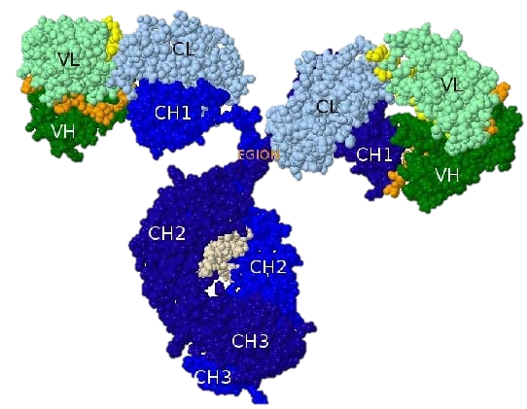
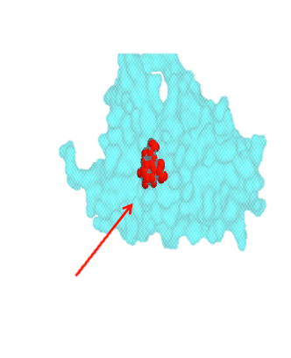

Особенности строения биологических веществ
Aspirin
Erythropoietin
Antibody (IgG)
Molecular weight
= 80 daltons
0 amino acids
Molecular weight
= 30,000 daltons
166 amino acids
Molecular weight
= 150,000 daltons ~1,300 amino acids
Notes:
This slide shows a side-by-side comparison of a low molecular weight drug (aspirin), a small protein (erythropoietin), and a biologic drug (eg, antibody). The level of complexity of a biologic drug is several orders of magnitude greater than a drug such as aspirin.

Slide 8
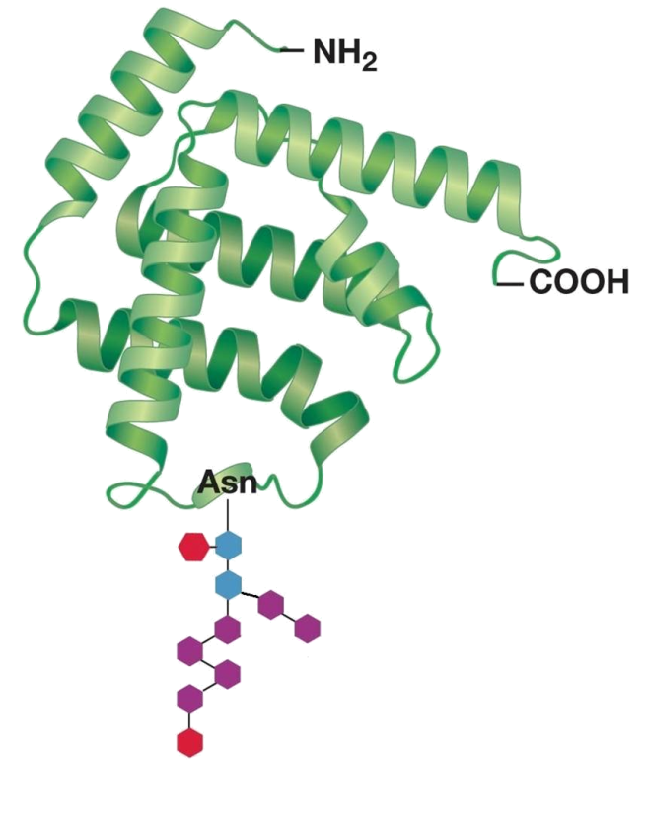
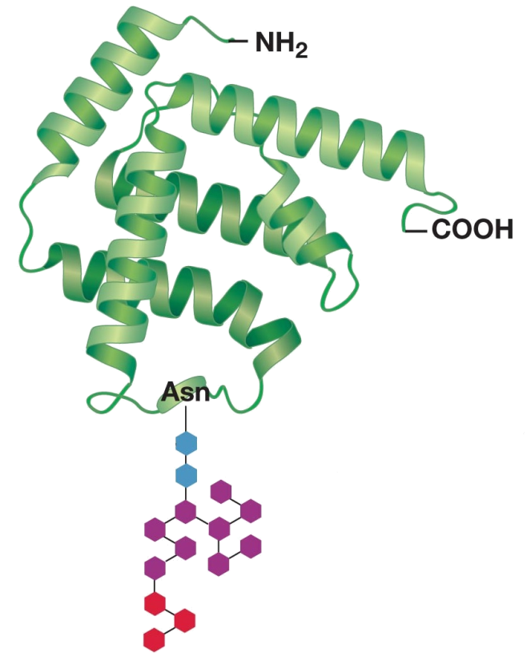
Каждая стадия производства оказывает влияние на конечную эффективность(посттрансляционная модификация)
Различные изоформы?
Схожие продукты, но не идентичные
Изменение активности, безопасности, иммуногенности
Revers L, Furczon E. Available at: http://cph.sagepub.com/content/143/4/184
Notes:
Glycosylation of biologic drugs is highly dependent on the manufacturing process. Biologics can have the same protein structure, but have different glycosylation patterns and very different activity.
Even subtle changes in the process can affect the glycosylation pattern, which can have effects on potency, and how the immune system recognizes the biologic drug.
The manufacturing process for biologics is divided into seven stages: host-cell development, master-cell bank establishment, protein production, purification, analysis, formulation, and storage and handling. Even slight alterations in any of these stages can lead to significant changes in protein structure with clinical implications for safety, immunogenicity, and potency. In particular, the glycosylation profile—the relative proportions of the various constituent glycoforms in a given batch—must be constantly monitored because imperceptible shifts in manufacturing conditions are known to alter the delicate balance of glycoform populations and therefore influence one or more characteristics of the active pharmaceutical ingredient (API), such as stability, resistance to degradation, circulatory half-life, biological activity, or the potential for adverse immune reactions in patients. The case of Eprex serves as a compelling example. It was found that minor manufacturing changes induced antibody-mediated pure red-cell aplasia (PRCA; an immune reaction in which the patient’s antibodies neutralize not only the drug, but also the body’s natural EPO) in chronic dialysis patients.
Reference:
1. Revers L, Furczon E. An introduction to biologics and biosimilars. Part II: Subsequent entry biologics: Biosame or biodifferent? Available at: http://cph.sagepub.com/content/143/4/184.

Slide 9
Чем отличаются биопрепараты от низкомолекулярных ЛС?
молекулярный вес
сложность структуры
характеристики:
структурные и физико-химические свойства
степень очистки белка
биологическая активность
стабильность
Иммуногенность!
Crommelin DJA, et al. Int J Pharm 2003;266:3-16.

Slide 10
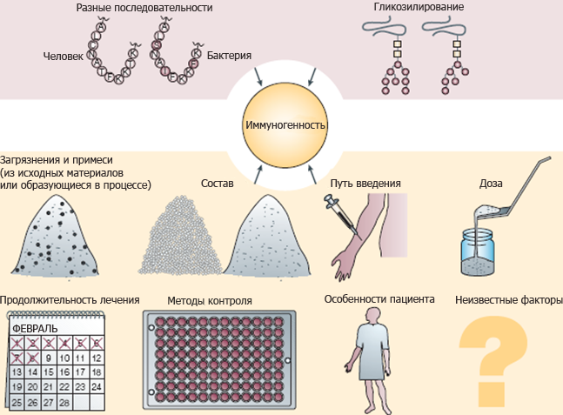
Факторы, влияющие на иммуногенность
Schellekens H. Nat Rev Drug Discov 2002:457–62
Notes:
Nephrologists have been confronted with the problem of PRCA because they prescribe a biopharmaceutical – epoetin – to treat renal anaemia. Biopharmaceuticals are medicines derived from substances naturally present in living organisms by using recombinant DNA technology.
The literature shows that PRCA is not an isolated example of the immunogenicity of biopharmaceuticals. Although biopharmaceuticals are designed to be copies of the endogenous biological molecule they replace, they may be sufficiently different to elicit an antibody response.¹
Potential causes of immunogenicity include: a biopharmaceutical having slightly different structural properties to the endogenous molecule; contaminants and impurities in the formulated product; and/or a number of factors related to product storage, handling, and administration.
In the case of antibody-mediated PRCA, the focus is on the formulation of epoetin and its route of administration, for the reasons discussed in the next slide.
Reference
Schellekens H. Nat Rev Drug Discov 2002;1:457-62.
Figure reproduced from Schellekens H. Bioequivalence and the immunogenicity of
biopharmaceuticals. Nat Rev Drug Discov 2002;1:457-62, by permission of the Nature
Publishing Group.

Slide 11
Частота иммунной реакции на ингибиторы фактора некроза опухоли (ФНО)

Slide 12
Сообщенные частоты появления антител к интерферону β-1a
Исследование | Определение положительной реакции на нейтрализующие антитела (Нат) | Метод анализа | Доза (в/м еженедельно) | Доля Нат-положительных пациентов (%)
Jacobs et al. (1996) [14] | Не сообщалось | Не указано | 30 мкг | 22*
Herden et al. (1999) [10] | Минимум 1 титр из 20 | ЦПЭ | 30 мкг | 5
Rudick et al. (1998) [34] | Минимум 1 титр из 20 | ЦПЭ | 30 мкг | 6
Jacobs et al. (2000) [13] | Минимум 1 титр из 20 | ЦПЭ | 30 мкг | 2
Clanet et al. (2002) [4] | Минимум 1 титр из 20 | ЦПЭ | 30 мкг 60 мкг | 2,3 5,8
в/м внутримышечно; ЦПЭ – анализ по цитопатическому эффекту *Частота Нат была выше, чем в более поздних исследованиях, поскольку Jacobs et al. [14] проводили исследования с использованием некоммерческого препарата, до того как в производственный процесс были внесены улучшения.
Взято из статьи Bertolotto et al J Neurology 2004

Slide 13
Иммуногенность рекомбинантных терапевтических белков
(H.Schellekens, 2002)
Рекомбинантный белок | Показания | Иммуногенность
Инсулин | Диабет | ~44% пациентов (5% IgE)
Гормон роста | ГР-дефицит | 3-16% пациентов
ЭПО | Анемия | 1:10 000 пациентов
Фактор VIII | Гемофилия | ~35% пациентов
IFN-α | Гепатит и др. | ~25% пациентов
IL-2 | Некоторые опухоли | 20-100% пациентов

Slide 14
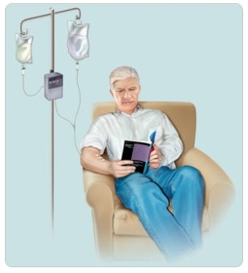
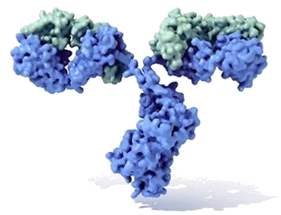

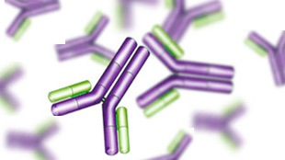

Последствия иммуногенности
Индукция иммунного ответа
Развитие НПР, гиперчувствительности
Нейтрализация эндогенных БАВ (F VIII)
Отсутствие эффекта
Изменение ФК
Schellekens H. Nat Rev Drug Discov 2002;1:457
Notes:
An immune reaction to a biologic molecule can have a number of outcomes to a patient if it induces the native immune response. Immune reactions can:
Neutralize effects of the biologic drug and compromise further therapy
Alter the pharmacokinetics of the drug
Cross-react with native proteins and induce adverse reactions (as in the case of PRCA)
Have no effect

Slide 15
Последствия образования антител
Потеря эффективности
Интерферон-альфа 2
Интерферона-бета
Ингибиторы ФНО
Агалсидаза-бета
и многие другие
Перекрестная нейтрализация эндогенных факторов
Эритропоэтин (ЭПО)
Фактор роста и развития мегакариоцитов (ФРРМ)
Анафилактические реакции, сывороточные реакции
Моноклональные антитела

Slide 16
Нейтрализующие антитела к ß-интерферону снижают эффективность лечения рассеянного склероза
 | Метод анализа антител | Препарат интерферона | Снижение эффективности (рецидивы, ЯМР или биомаркеры)
PRISMS 4 (2005) | ЦПЭ | Ребиф® | Да
Исслед. группа IFNβ (1996) | ЦПЭ | Бетаферон® | Да
Европейская исслед. группа IFNβ (1998) и (1999) | ЦПЭ | Бетаферон®
Deisenhammer et al. (1999) | ИФА тест на белок MxA | Бетаферон® | Да
Cook et al. (2001) | ЦПЭ; неоптериновый тест | Авонекс®; Бетаферон® | Да
Vallittu et al. (2002) | ЦПЭ; тест на белок MxA | Ребиф® 22 | Да
Bertolotto et al. (2005) | ЦПЭ; тест на иРНК белка MxA | Авонекс®; Ребиф® 22; Бетаферон® | Да
Pachner et al. (2003) | ЦПЭ; иРНК белка MxA; ОАС | Не сообщалось | Снижение биомаркеров
Malucchi et al. (2004) | ЦПЭ | Авонекс®; Ребиф® 22; Бетаферон® | Да
Petkau et al. (2004) | ЦПЭ; тест на белок MxA | Бетаферон® | Да
Perini et al. (2004) | ЦПЭ | Авонекс®; Ребиф® 22; Бетаферон® | Да
Kappos et al. (2005) | ЦПЭ | Авонекс® 30 мкг; Авонекс® 60 мкг | Да
Sorensen et al. (2003) | ЦПЭ | Авонекс® 30 мкг OW; Ребиф® 22 мкг OW; Ребиф® 22 мкг TTW; Бетаферон® 8 ММЕ/2сут | Нейтрализазия интерферона
.
Взято из статьи R.A. Farrell и G. Giovannoni, Измерение и контроль антител к интерферону бета у больных рассеянным склерозом (Measuring and management of anti-interferon beta antibodies in subjects with multiple sclerosis), Mult. Scler. 13 (5) (Jun 2007), pp. 567–577.

Slide 17
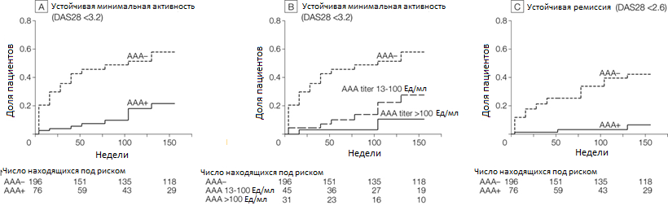
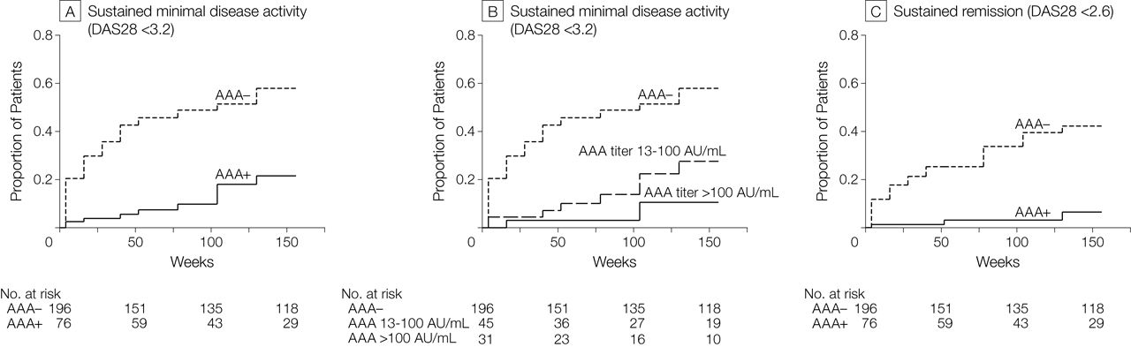

Рисунок 5. Состояния устойчивой активности заболевания и ремиссии у пациентов с антителами к адалимумабу (ААА) и без них
Bartelds, G. M. et al. JAMA 2011;305:1460-1468
Copyright restrictions may apply.
Notes:
A, Proportion of patients who reached sustained minimal disease activity score (DAS28 < 3.2) for patients with and without antiadalimumab antibodies (AAA) (survival analysis; P < .001). Ninety-five of 196 patients without AAA reached sustained minimal disease activity vs 10 of 76 patients with AAA. B, Proportion of patients who reached sustained DAS28 (< 3.2) for patients without AAA, patients with low AAA titers (13-100 AU/mL), and patients with high AAA titers (> 100 AU/mL). Both curves with AAA differ significantly from the curve without AAA (survival analysis, P < .001). Ninety-five of 196 patients without AAA reached sustained minimal disease activity vs 8 of 45 patients with low AAA titers (13-100 AU/mL), and 2 of 31 patients with high AAA titers (>100 AU/mL). C, Indicates proportion of patients who reached sustained remission (DAS28 < 2.6) for patients with and without AAA (survival analysis, P < .001). Sixty-seven of 196 patients without AAA reached remission vs 3 of 76 patients with AAA.

Slide 18
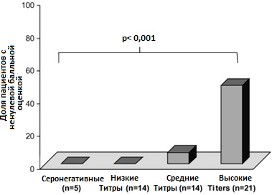
Влияние антител на эффективность агалсидазы-бета при болезни Фабри
Benichou et al . Молекулярные механизмы и генетика (2008)

Slide 19
Биоаналог = дженерик
Почему надо с особенной осторожностью говорить о взаимозаменяемости биологических лекарственных средств?
«Биоаналог - это биологическое лекарственное средство, схожее с оригинальным биологическим лекарственным средством, но не являющееся его дженериком в связи с различиями в исходном сырье и производстве оригинального биологического лекарственного средства и биоаналога…»
Источник: Переведено из Article 10 (2) b of Directive 2001/83 as amended

Slide 20
Регулирование производства и применения биоаналогов в ЕС
amended Directive 2001/83/EC
(2003/63/EC, 2004/27/EC)
Overarching Guidelines (CHMP/437/04)
Quality Guidelines (CHMP/49348/05)
Non-Clin & Clin Guidelines (CHMP/42832/05)
r-Human Insulin Guidance (CHMP/42832/05)
r-α-Interferon Guidance (CHMP/102046/06)
Somatropin Guidance (CHMP/94528/05)
Low Molecular Weight Heparin Guidance (CHMP/118264/2007)
r-GCSF Guidance (CHMP/31329/05)
Immunogenicity Guidance (CHMP/14327/06)
r-Erythropoeitin Guidance (CHMP/94526/05)
Guidelines under preparation
Notes:
As done for different other biological compounds, as insulin, somatotropin hormons or even EPO, the EMEA issued a specific guideline on biosimilarity of LMWH.

Slide 21
Результаты сравнительного исследования препаратов эпоэтина альфа
Singh A. K.
Brigham and Women’s hospital & Harvard Medical School, Boston, USA.
World Congress of Nephrology – Apr 22, 2007
Были протестированы 47 образцов из следующих стран: Аргентины, Бразилии, Колумбии, Индии, Индонезии, Ирана, Иордании, Кореи, Ливана, Нигерии, Филиппин, России, Таиланда, Венесуэлы, Вьетнама и Йемена
Образцы были протестированы согласно требованиям качества Европейской Фармакопеи для эпоэтина альфа. В качестве эталона сравнения использовался Эпрекс® (эпоэтин альфа)
Singh AK. Poster presented at the World Congress of Nephrology, 21-25 April 2007, Rio de Janeiro, Brazil

Slide 22
Результаты исследования Singh A. K.
pH
9 образцов имели отклонения от требований спецификации
Осмолярность
21 образец имел большую осмолярность
Содержание белка и эритропоэтина
1 экземпляр не отвечал требованиям спецификации по содержанию белка
8 экземпляров имели большее количество эритропоэтина
Биологическая проба In vitro
1 образец не соответствовал требованиям спецификации
18 образцов имели отклонения от требований спецификации
Эффективность In vivo
Различия в эффективности от 48% до 163%
9 образцов не отвечали требованиям спецификации
6 образцов имели отклонения от требований спецификации
Бактериальный эндотоксин
2 образца содержали бактериальный эндотоксин
Singh AK. Poster presented at the World Congress of Nephrology, 21-25 April 2007, Rio de Janeiro, Brazil

Slide 23
Результаты исследования Singh A. K.
Содержание агрегатов
29 образцов превосходили спецификацию по кол-ву агрегатов
7 образцов имели от > 1% до < 2% агрегатов
4 образцов имели от 2% до 4% агрегатов
18 образцов имели > 4% агрегатов
Содержание изоформ
34 образца имели больше изоформ, что может снижать клинический эффект
9 из 34 образцов имели ≥ 3 дополнительных изоформы
Singh AK. Poster presented at the World Congress of Nephrology, 21-25 April 2007, Rio de Janeiro, Brazil

Slide 24
Результаты сравнительного исследования препаратов эпоэтина альфа (продолжение)
Биоаналог эпоэтина | Биопроба in-vitro | Эффективность in-vivo на мышах % | Бактериальный эндотоксин (EU/ml) | Агрегаты %
Стандарт (Eprex®) | 80-125 | 80-125 | < 2,5 | < 1
Эпокрим 1 | 94 | 73 | < 0,5 | < 1
Эпокрим 2 | 175 | 76 | < 0,5 | 2,4
Эпокин 1 | 84 | 91 | < 0,5 | 1,7
Эпокрин 1 | 167 | 135 | < 0,5 | 1,2
Эпокрин 2 | 155 | 117 | < 0,5 | >4
Эпокрин 3 | 175 | 149 | < 0,5 | < 1
Эпорон | 170 | 163 | < 0,5 | > 4
Эпоет | 141 | 95 | < 0,5 | 2,7
Герепо | 141 | 48 | < 0,5 | > 4
Хемакс 1 | 139 | 97 | < 0,5 | > 4
Хемакс 2 | 132 | 101 | < 0,5 | > 4
Хемакс 3 | 141 | 90 | < 0,5 | > 4
Гиперкрит | 153 | 113 | < 0,5 | > 4
Реноген | 110 | 108 | < 0,5 | > 4
Вепокс | 177 | 57 | > 2,5 | > 4
Зироп | 142 | Дважды неудачно | < 0,5 | > 4

Slide 25
Результаты сравнительного исследования препаратов эпоэтина альфа (продолжение)
Общее количество дополнительных изоформ
0
1
2
3
4
5
Эпоким | 1
 | 2
 | 3
Эпокрин | 1
 | 2
 | 3
Эпорон
Эповет | 1
 | 2
Эспоген | 1
 | 2
 | 3
Геерепo
Хемакс | 1
 | 2
 | 3
Гиперкрит | 1
 | 2
Вепокс
Зироп | 1
 | 2
 |  |  |  |  | Щелочные изоформы
 |  |  |  |  | Кислые изоформы

Slide 26
Выводы по результатам сравнительного исследования препаратов эпоэтина альфа:
Несколько из протестированных биоаналогов эпоэтина имело непостоянные качество и эффективность; 42 из 47 образцов не соответствовали всем Европейским требованиям для эпоэтина альфа
34 образца содержали дополнительные щелочные изоформы, которые могут снижать клиническую эффективность препарата
2 образца содержали бактериальный эндотоксин, который представляет собой риск для безопасности пациента
22 образца содержали более 2% агрегатов, которые могут влиять на иммунологический профиль препарата
Обнаруженные отличия приводят к непредсказуемым нежелательным явлениям в клинической практике
Исследованные биоаналоги имели отличия в различных сериях одного и того же препарата
Специалистам, применяющим в своей практике
воспроизведенные препараты эпоэтина,
следует внимательно отслеживать их эффективность
и безопасность
Singh AK. Poster presented at the World Congress of Nephrology, 21-25 April 2007, Rio de Janeiro, Brazil

Slide 27
Индукция синтеза ГИТ-антител
Saline 5. Reviparin
Dalteparin 6. Parnaparin
Enoxaparin 7. Tinzaparin
Nadroparin 8. Heparin
Dose: 1 mg/kg IV
Circulation time: 15 min.
Dose: 1 mg/kg IV
Circulation time: 15 min.
Dose: 1 mg/kg IV
Circulation time: 15 min.
Dose: 1 mg/kg IV
Circulation time: 15 min.
Dose: 1 mg/kg IV
Circulation time: 15 min.
Dose: 1 mg/kg IV
Circulation time: 15 min.
Dose: 1 mg/kg IV
Circulation time: 15 min.
In Vitro Cross-Reactivity of Branded LMWHs (1 μg/mL) with HIT Antibodies in the Platelet Aggregation Assay
W.P.Jeske
J.Walenga
Immunogenicity of Low Molecular Weight Heparins and Their Biosimilars
Abstract &
Poster #
ASH
July 09
Saline 5. Dilutol
Clenox 6. Lupenox
Cutenox 7. Daltehep
Dripanina
The antithrombotic activities of Lovenox and several generic LMWHs were compared following administration of a dose of 1 mg/kg to rats using a laser-induced thrombosis model in which the number of laser shots required to induce the formation of a thrombus with length = 1.5x vessel width is taken as an index of antithrombotic activity. Blood samples were collected immediately after the endpoint was reached to determine circulating anti-Xa levels. The measured anti-Xa levels did not correlate with the observed antithrombotic activity.
The antithrombotic activities of Lovenox and several generic LMWHs were compared following administration of a dose of 1 mg/kg to rats using a laser-induced thrombosis model in which the number of laser shots required to induce the formation of a thrombus with length = 1.5x vessel width is taken as an index of antithrombotic activity. Blood samples were collected immediately after the endpoint was reached to determine circulating anti-Xa levels. The measured anti-Xa levels did not correlate with the observed antithrombotic activity.
The antithrombotic activities of Lovenox and several generic LMWHs were compared following administration of a dose of 1 mg/kg to rats using a laser-induced thrombosis model in which the number of laser shots required to induce the formation of a thrombus with length = 1.5x vessel width is taken as an index of antithrombotic activity. Blood samples were collected immediately after the endpoint was reached to determine circulating anti-Xa levels. The measured anti-Xa levels did not correlate with the observed antithrombotic activity.
The antithrombotic activities of Lovenox and several generic LMWHs were compared following administration of a dose of 1 mg/kg to rats using a laser-induced thrombosis model in which the number of laser shots required to induce the formation of a thrombus with length = 1.5x vessel width is taken as an index of antithrombotic activity. Blood samples were collected immediately after the endpoint was reached to determine circulating anti-Xa levels. The measured anti-Xa levels did not correlate with the observed antithrombotic activity.
The antithrombotic activities of Lovenox and several generic LMWHs were compared following administration of a dose of 1 mg/kg to rats using a laser-induced thrombosis model in which the number of laser shots required to induce the formation of a thrombus with length = 1.5x vessel width is taken as an index of antithrombotic activity. Blood samples were collected immediately after the endpoint was reached to determine circulating anti-Xa levels. The measured anti-Xa levels did not correlate with the observed antithrombotic activity.
The antithrombotic activities of Lovenox and several generic LMWHs were compared following administration of a dose of 1 mg/kg to rats using a laser-induced thrombosis model in which the number of laser shots required to induce the formation of a thrombus with length = 1.5x vessel width is taken as an index of antithrombotic activity. Blood samples were collected immediately after the endpoint was reached to determine circulating anti-Xa levels. The measured anti-Xa levels did not correlate with the observed antithrombotic activity.
In Vitro Cross-Reactivity of Biosimilar Versions of Enoxaparin and Dalteparin (1 μg/mL) with HIT Antibodies in the Platelet Aggregation Assay
The antithrombotic activities of Lovenox and several generic LMWHs were compared following administration of a dose of 1 mg/kg to rats using a laser-induced thrombosis model in which the number of laser shots required to induce the formation of a thrombus with length = 1.5x vessel width is taken as an index of antithrombotic activity. Blood samples were collected immediately after the endpoint was reached to determine circulating anti-Xa levels. The measured anti-Xa levels did not correlate with the observed antithrombotic activity.
+
+
*
*
Hemorrhagic tendencies for Lovenox and several generic enoxaparins were compared following intravenous administration of a dose of 5 mg/kg to rabbits using an ear bleeding model. Variable amounts of blood loss were observed in animals treated with the generic enoxaparins.
Notes:
Heparin-induced thrombocytopenia (HIT) is the most common of the known immunogenic responses to heparin. Although symptomatic HIT infrequently occurs in patients treated with LMWHs, anti-heparin/PF4 antibodies (HIT antibodies) do develop in up to 25% of treated patients. The prevalence of antibody generation is dependent on the type of LMWH, dosage, and type of patient.
Micro-chemical differences in the heparin molecules affect its biological activities. If compositional variations exist between an innovator and biosimilar LMWH, interactions with endogenous proteins such as platelet factor 4 (PF4) would differ, resulting in a differential immunogenic response between drugs.
Preclinical comparative studies to establish immunosimilarity, are required by FDA, however they are considered not predictive enough.
Moreover these in vitro assays using plasma of HIT patients collected from different clinical assays, confirmed differences in response to HIT antibodies, across LMWHs as well as between biosimilars to the branded product.
.

Slide 28
CT-P13-
Remsima, Inflectra, Flammegis
Одобрен корейским регулятором
Выход на рынок Кореи: ноябрь 2012
EMA одобрение: сентябрь 2013
Remsima, Flammegis by Celltrion/Egis
Inflectra by Hospira
Каковы доказательства аналогичности на сегодняшний день?

Slide 29
PLANET-RA/AS
Study population:
Active RA or AS
Randomization
CT-P13 (3 or 5 mg/kg IV), N=302 / 125
Reference drug (3 or 5 mg/kg IV), N=302 / 125
Week 30
Primary endpoint
Week 30
Up to Week 102
Up to Week 102
Notes:
From the regulatory point of view, it is recommended to conduct PK study within the current indications of reference product.
To meet this recommendation, active AS patients according to modified 1984 New York criteria were selected. Healthy volunteers were excluded since they might have different status compared to diseased patients.
Regarding the timing of comparison in terms of PK primary endpoints, steady state at Week 30 was selected because of two reasons.
First, current dosing schedule is Week 0, 2, 6 and then every 6 to 8 weeks which makes it difficult to test AUC after first dose.
Second, many of regulatory agencies suggest steady state for PK study with multiple dosing or exposure.
At week 30, PK, safety and efficacy endpoints have been evaluated and reported.
Secondary endpoints and safety parameters would be followed up to Week 54.

Slide 30

PLANET-RA
% patients
Yoo D et al. Ann Rheum Dis 2013
Notes:
From the regulatory point of view, it is recommended to conduct PK study within the current indications of reference product.
To meet this recommendation, active AS patients according to modified 1984 New York criteria were selected. Healthy volunteers were excluded since they might have different status compared to diseased patients.
Regarding the timing of comparison in terms of PK primary endpoints, steady state at Week 30 was selected because of two reasons.
First, current dosing schedule is Week 0, 2, 6 and then every 6 to 8 weeks which makes it difficult to test AUC after first dose.
Second, many of regulatory agencies suggest steady state for PK study with multiple dosing or exposure.
At week 30, PK, safety and efficacy endpoints have been evaluated and reported.
Secondary endpoints and safety parameters would be followed up to Week 54.

Slide 31
PLANET-AS
% patients
Park W et al. Ann Rheum Dis 2013

Slide 32
CT-P13 Open Label Extension Trials in RA and AS
Open label extension, all pts receiving CT-P13
Approx. 66% entering OLE
CT-P13
Continue CT-P13
R
Remicade
Switch to CT-P13
Double-blind
Open label extension
Wk 0
Wk 54
Wk 102
Posters presented as late breaking abstracts at ACR 2013
Notes:
#L1
Efficacy and Safety of CT-P13 (Infliximab biosimilar) over Two Years in Patients with Rheumatoid Arthritis: Comparison Between Continued CT-P13 and Switching from Infliximab to CT-P13
October 29 2:30 PM 6 A
ACR Late-Breaking Abstract Oral Session (/apps/MyAnnualMeeting/Session/5665) Late-Breaking Oral
Background/Purpose: CT-P13 is a biosimilar of infliximab (INX), approved by the European Medicines Agency. The objective
of this open-label Phase 3 extension study was to confirm long-term efficacy and safety of CT-P13 and to investigate switching
from INX to CT-P13, in patients (pts) with rheumatoid arthritis (RA).
Methods: The PLANETRA Study was a 54-week (wk), randomized, double-blind, parallel-group study demonstrating efficacy
and safety equivalence of CT-P13 (3 mg/kg) compared with INX when co-administered with methotrexate (12.5-25 mg/wk) and
folic acid (≥5 mg/wk, oral dose) every 8 wks in pts with RA (Yoo DH ARD2013;72(S3):73). In total, 302/455 pts who completed
the scheduled visits were entered into the open-label extension phase for an additional 48 wks: 158 pts were maintained with
CT-P13 (maintenance group) and 144 pts switched from INX to CT-P13 (switch group). Efficacy (including ACR20/50/70) and
safety assessments including immunogenicity were monitored throughout the study.
Results: At wk 54, ACR20/50/70 response rate were similar between groups (CT-P13: 76.8%/45.7%/21.9%; INX
77.5%/50.0%/23.9%, respectively). At wk 78, ACR20/50/70 response rate was comparable for the maintenance group
(71.5%/48.3%/24.5%) and switch group (78.2%/47.9%/29.6%). Through wk 102, ACR20/50/70 response rates were
maintained and were similar in each group; 72.2%/48.3%/24.5% and 71.8%/51.4%/26.1%, respectively. Good and moderate
EULAR-CRP responses at wks 54, 78 and 102 were observed in 89.4%/79.5%/81.5% of pts in the maintenance group and
87.3%/85.9%/76.8% of pts in the switch group, respectively. Changes in DAS28-CRP from baseline were comparable between
the two groups: −2.4/−2.4/−2.4 in the maintenance group; −2.4/−2.6/−2.5 in the switch group, at wks 54, 78 and 102
respectively). EULAR-ESR response rates and DAS28-ESR results were also comparable between groups (Table). The
proportion of pts positive for anti-drug antibody (ADA) was comparable between the two groups throughout the study and ADA
positivity did not increase significantly during year 2 when both groups were receiving CT-P13: maintenance group, 49.1%,
50.4% and 46.4%; switch group, 49.3%, 49.6% and 49.6% at wk 54, 78 and 102, respectively. The number of pts with at least
one AE or SAE was comparable (Table). Infusion-related reactions were seen in 10 pts (6.3%) in the maintenance group and
in 4 pts(2.8%) in the switch group (p=0.1781). There were no reports of TB infections in either group. Malignancies were
reported in 1 pt (ovarian cancer) in the maintenance group and in 4 pts (breast cancer, T-cell lymphoma, ovarian cancer and
myeloproliferative disorder) in the switch group.
Conclusion: CT-P13 was well tolerated and effective over 2 years in pts with active RA. The efficacy and safety profiles of the
maintenance group and the switch group were comparable during this extension study.
D. H. Yoo, Celltrion Inc, 5; N. Prodanovic, None; J. Jaworski, None; P. Miranda, None; E. B. Ramiterre, None; A. Lanzon,
None; A. Baranauskaite, None; P. Wiland, None; C. Abud-Mendoza, None; B. Oparanov, None; S. Smiyan, Celltrion Inc, 5; Y.
Son, Celltrion Inc, 3; W. Park, Celltrion Inc, 5; U. Müller-Ladner, Celltrion Inc, 5, Celltrion Inc, 8.

Slide 33
Continued CT-P13 vs Switching From Remicade to CT-P13 in PLANET-RA
Wk 52
Wk 78
Wk 102
Percent of patients (%)
Yoo et al. ACR 2013, L1
Notes:
#L1
Efficacy and Safety of CT-P13 (Infliximab biosimilar) over Two Years in Patients with Rheumatoid Arthritis: Comparison Between Continued CT-P13 and Switching from Infliximab to CT-P13
October 29 2:30 PM 6 A
ACR Late-Breaking Abstract Oral Session (/apps/MyAnnualMeeting/Session/5665) Late-Breaking Oral
Background/Purpose: CT-P13 is a biosimilar of infliximab (INX), approved by the European Medicines Agency. The objective
of this open-label Phase 3 extension study was to confirm long-term efficacy and safety of CT-P13 and to investigate switching
from INX to CT-P13, in patients (pts) with rheumatoid arthritis (RA).
Methods: The PLANETRA Study was a 54-week (wk), randomized, double-blind, parallel-group study demonstrating efficacy
and safety equivalence of CT-P13 (3 mg/kg) compared with INX when co-administered with methotrexate (12.5-25 mg/wk) and
folic acid (≥5 mg/wk, oral dose) every 8 wks in pts with RA (Yoo DH ARD2013;72(S3):73). In total, 302/455 pts who completed
the scheduled visits were entered into the open-label extension phase for an additional 48 wks: 158 pts were maintained with
CT-P13 (maintenance group) and 144 pts switched from INX to CT-P13 (switch group). Efficacy (including ACR20/50/70) and
safety assessments including immunogenicity were monitored throughout the study.
Results: At wk 54, ACR20/50/70 response rate were similar between groups (CT-P13: 76.8%/45.7%/21.9%; INX
77.5%/50.0%/23.9%, respectively). At wk 78, ACR20/50/70 response rate was comparable for the maintenance group
(71.5%/48.3%/24.5%) and switch group (78.2%/47.9%/29.6%). Through wk 102, ACR20/50/70 response rates were
maintained and were similar in each group; 72.2%/48.3%/24.5% and 71.8%/51.4%/26.1%, respectively. Good and moderate
EULAR-CRP responses at wks 54, 78 and 102 were observed in 89.4%/79.5%/81.5% of pts in the maintenance group and
87.3%/85.9%/76.8% of pts in the switch group, respectively. Changes in DAS28-CRP from baseline were comparable between
the two groups: −2.4/−2.4/−2.4 in the maintenance group; −2.4/−2.6/−2.5 in the switch group, at wks 54, 78 and 102
respectively). EULAR-ESR response rates and DAS28-ESR results were also comparable between groups (Table). The
proportion of pts positive for anti-drug antibody (ADA) was comparable between the two groups throughout the study and ADA
positivity did not increase significantly during year 2 when both groups were receiving CT-P13: maintenance group, 49.1%,
50.4% and 46.4%; switch group, 49.3%, 49.6% and 49.6% at wk 54, 78 and 102, respectively. The number of pts with at least
one AE or SAE was comparable (Table). Infusion-related reactions were seen in 10 pts (6.3%) in the maintenance group and
in 4 pts(2.8%) in the switch group (p=0.1781). There were no reports of TB infections in either group. Malignancies were
reported in 1 pt (ovarian cancer) in the maintenance group and in 4 pts (breast cancer, T-cell lymphoma, ovarian cancer and
myeloproliferative disorder) in the switch group.
Conclusion: CT-P13 was well tolerated and effective over 2 years in pts with active RA. The efficacy and safety profiles of the
maintenance group and the switch group were comparable during this extension study.
D. H. Yoo, Celltrion Inc, 5; N. Prodanovic, None; J. Jaworski, None; P. Miranda, None; E. B. Ramiterre, None; A. Lanzon,
None; A. Baranauskaite, None; P. Wiland, None; C. Abud-Mendoza, None; B. Oparanov, None; S. Smiyan, Celltrion Inc, 5; Y.
Son, Celltrion Inc, 3; W. Park, Celltrion Inc, 5; U. Müller-Ladner, Celltrion Inc, 5, Celltrion Inc, 8.

Slide 34
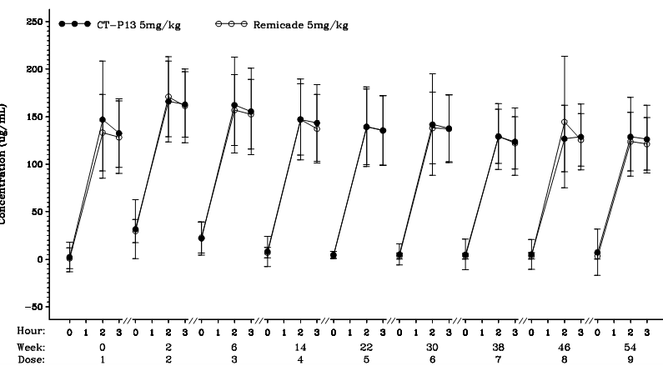
Pharmacokinetic Equivalence of CT-P13 to infliximab
PLANET-AS
Mean serum concentration of Reference drug vs time (dose 1 to 9)
Park W et al. Ann Rheum Dis 2013
Notes:
We had same result for Cmax at steady state.
The ratio of two geometric means were 101.47.
90% of confidence interval lay within 80 to 125%, so we can conclude two Reference drugs are equivalent in terms of Cmax.
In addition to primary endpoint analysis, we have monitored Cmax in every dose. The result are similar in each dose as you see on this slide.

Slide 35
Частота инфекций
PLANET-AS
 | Remsima 5 mg/kg (n = 128) | Infliximab 5 mg/kg (n = 122)
Total No. of patient with infection and infestation | 55 | 49
Park W et al. Ann Rheum Dis 2013
Notes:
Two TB cases have been reported for Remsima and 1 for originator Reference drug.
The result is comparable to historical data.
For your reference, ATTRACT study with active RA reported 1.2% of TB cases and
ASPIRE with early RA reported 0.8% of TB cases.

Slide 36
Remsima/Inflectra - Extrapolation of indications
Summary
“Based on the robust comparisons of the physicochemical and in vitro and ex vivo biological analyses, Remsima was considered biosimilar to the reference product Remicade. These data, in combination with clinical data demonstrating pharmacokinetic and therapeutic equivalence in rheumatology conditions, allow for extrapolation to all other indications of Remicade.”
Rheumatoid arthritis, ankylosing spondylitis
Psoriatic arthritis, psoriasis, Crohn’s disease, ulcerative colitis
Paediatric Crohn’s disease, paediatric ulcerative colitis

Slide 37
EU guideline on extrapolation of indications^{1,2}
Possible based on the overall evidence of comparability provided from the comparability exercise and with adequate justification.
This includes at least one clinical study in the most sensitive patient population measuring the most sensitive clinical endpoint(s).
If for the claimed indications different mechanisms of action are relevant (or uncertainty exists), then applicants should provide relevant data to support extrapolation.
Applicants should support such extrapolations with a comprehensive discussion of available literature including the involved antigen receptor(s) and mechanism(s) of action.
Whether extrapolation to multiple indications is acceptable (or not) is decided on a case-by-case basis by the CHMP/EMA.
¹ Guideline on similar biological medicinal products containing monoclonal antibodies – non-clinical and clinical issues; EMA/CHMP/BMWP/403543/2010.
² European Commission Consensus Information Paper 2013. What you need to know about Biosimilar Medicinal Products.

Slide 38
Anti-Drug Antibody Formation Rate in Various Indications*:
Какая популяция пациентов наиболее чувствительна?
RA=rheumatoid arthritis; PsA=psoratic arthritis; AS= Ankylosing spondylitis; JIA=juvenile ideopathic arthritis; CD=Crohn’s Diisease; Ps=Psoriais; MTX=Methotrexate; IMS=Immunomodulator(s); IFX=Infliximab
*percentages not shown are not available in HUMIRA’s US PI

Slide 39
EU guideline on extrapolation of indications^{1,2}
Possible based on the overall evidence of comparability provided from the comparability exercise and with adequate justification.
This includes at least one clinical study in the most sensitive patient population measuring the most sensitive clinical endpoint(s).
If for the claimed indications different mechanisms of action are relevant (or uncertainty exists), then applicants should provide relevant data to support extrapolation.
Applicants should support such extrapolations with a comprehensive discussion of available literature including the involved antigen receptor(s) and mechanism(s) of action.
Whether extrapolation to multiple indications is acceptable (or not) is decided on a case-by-case basis by the CHMP/EMA.
¹ Guideline on similar biological medicinal products containing monoclonal antibodies – non-clinical and clinical issues; EMA/CHMP/BMWP/403543/2010.
² European Commission Consensus Information Paper 2013. What you need to know about Biosimilar Medicinal Products.

Slide 40
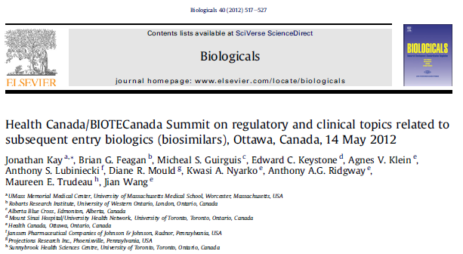
Expert Opinion on Extrapolation
The mechanism of action for REMICADE® in Rheumatoid Arthritis is not necessarily similar in IBD^{1,2}. Therefore, clinical outcomes in one indication may not be applicable in another.
“… the mechanisms of action of the TNFa antagonists are not completely understood, and that subtle molecular differences in a biologic drug may alter binding to targets in the body and lead to different clinical effects” ¹ (Brian G. Feagan, MD, FRCPC).
“it may not be possible to extrapolate clinical data for a monoclonal antibody in one rheumatologic indication to other rheumatologic indications because of differences in dose, duration of therapy, efficacy of monotherapy vs. combination therapy, and stated claims of efficacy for those indications” ¹ (Jian Wang, MD, PhD, Health Canada).
¹Kay et al. 2012; Biologicals 40:517-27.
²Ordas et al. Clin Pharm and Ther. 2012.
Notes:
Extrapolation: refers to the evaluation by Health Canada of a proposal to grant additional indications held by the reference biologic drug to the SEB in the absence of such clinical data
#### PLEASE DO NOT DELETE CONTENT BELOW THIS LINE ! ####
Author: David Zante (Access)
Intended Use: External distribution upon request
Approval Date: April 17, 2013 Review By: Medical Information

Slide 41
Extrapolation: Clinical data availability
 | RA | AS | PsA | PSO | CD | UC | Pediatric CD | Pediatric UC
INFLIXIMAB | ü | ü | ü | ü | ü | ü | ü | ü
CT-P13 | ü | ü | ✗ | ✗ | ✗ | ✗ | ✗ | ✗
Notes:
This slide shows how extrapolation is being used for CT-P13. Clinical trials with Remicade in all the listed indications have resulted in differences in therapy type (mono- or combination therapy), dosing, and frequency of administration between diseases. CT-P13 has completed two clinical trials with different parameters from Remicade and will extrapolate this to the other diseases.
Infliximab
ATTRACT: RA; combination therapy; 3 mg/kg (0,2,6) induction dose, 5 mg/kg (q4–8w) maintenance dose; ACR20 primary end point
ASSERT: AS; monotherapy; 5 mg/kg (0,2,6) induction dose, 5 mg/kg (q6–8w) maintenance dose; ASAS20 primary end point
IMPACT 2: PsA; mono- or combination therapy; 5 mg/kg (0,2,6) induction dose, 5 mg/kg q8w maintenance dose; ACR20 primary end point
ACCENT I: CD; monotherapy; 5 mg/kg (0,2,6) induction dose, 5–10 mg/kg q8w maintenance dose; CDAI primary end point
REACH: pediatric CD; monotherapy; 5 mg/kg (0,2,6) induction dose, 5 mg/kg q8w maintenance dose; PCDAI primary end point
ACT 1/2: UC; monotherapy; 5 mg/kg (0,2,6) induction dose, 5–10 mg/kg q8w maintenance dose; Mayo score (response) primary end point
T72: pediatric UC; monotherapy; 5 mg/kg (0,2,6) induction dose, 5 mg/kg q8w maintenance dose; Mayo score (response) primary end point
EXPRESS: PSO; monotherapy; 5 mg/kg (0,2,6) induction dose, 5 mg/kg q8w maintenance dose; PASI75
CT-P13
PLANETRA: RA; combination therapy; 3 mg/kg (0,2,6) induction dose, 3 mg/kg q8w maintenance dose; ACR20 primary end point
PLANETAS: AS; monotherapy; 5 mg/kg (0,2,6) induction dose, 5 mg/kg q8w maintenance dose; PK AUC_{T}, C_{max,ss} primary end points

Slide 42
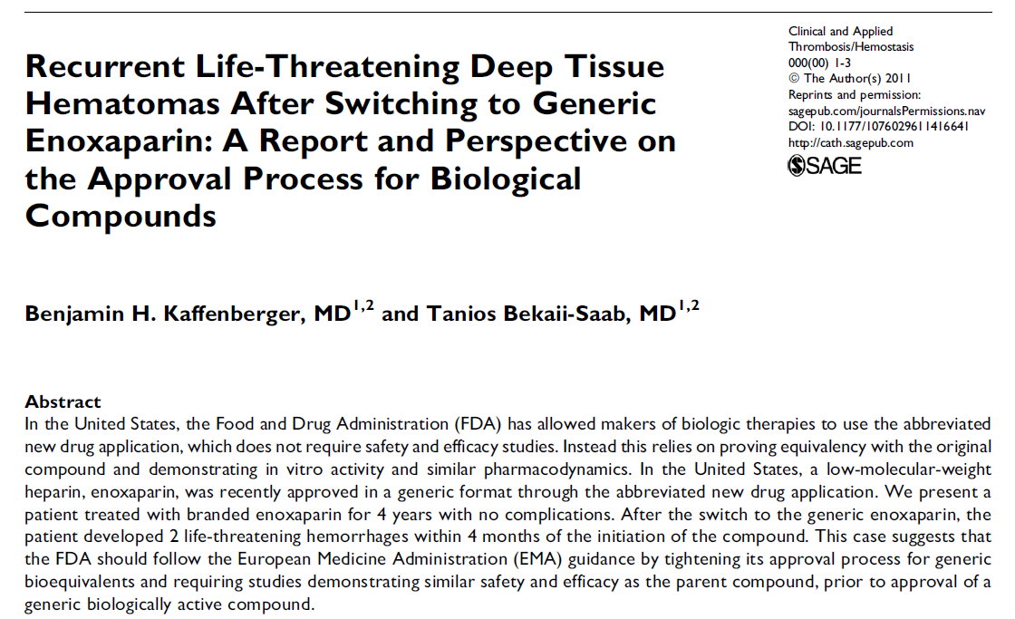
Клинический случай: замена Клексана на генерик
Биологические препараты и биоаналоги Клинический случай
Пациент принимал 4 года Клексан без осложнений . После перехода на биоаналог эноксапарина, у пациента было 2 угрожающих жизни кровотечений в течение 4 месяцев после начала использования.
Этот случай показывает, что FDA должна следовать рекомендации EMA по ужесточению процесса утверждения биоаналогов: биоэквивалентность и исследования, демонстрирующие безопасность и эффективность, сходную с оригинальным препаратом, до утверждения биоаналога.
Notes:
Этот случай показывает, что FDA необходимо перенять европейский опыт EMA в отношении процесса регистрации биоаналогов, которая возможна только в случае демонстрации клинически доказанной безопасности и эффективности в ходе сравнительных исследований с оригинальным биопрепаратом с участием пациентов и по всем показаниям.

Slide 43
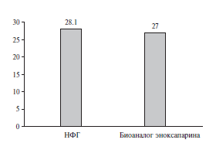
Биологические препараты и биоаналоги Результаты клинической предоперационной практики
Цель. Оценка эффективности профилактики тромбоэмболических осложнений в предоперационном периоде с помощью НФГ и биоаналога эноксапарина.
Результаты. Частота тромбоза вен нижних конечностей достоверно не отличалась у пациентов, получавших НФГ и биоаналог эноксапарина.
Заключение. Отсутствие выраженных преимуществ биоаналога эноксапарина перед НФГ может быть связано с неоднородностью первичного сырья, используемого для изготовления оригинального и эноксапарина и биоаналога.
Биоаналог эноксапарина по эффективности в профилактике ВТЭО не отличался от НФГ
Частота (%) тромбоза вен нижних конечностей
перед операцией
М.В.Белов, А.С.Петроченко, Е.М.Позднякова, В.В.Якусевич. Эффективность различных режимов профилактике
тромбоэмболических осложнений в клинической практике (ретроспективное исследование). Клиническая Фармакологияи терапия, 2012, 21 (4)
Notes:
Ярославской областная клиническая больница скорой медицинской помощи им. Н.В.Соловьева было проведено ретроспективное исследование по оценке эффективности различных режимов профилактике тромбоэмболических осложнений в клинической
практике. Ретроспективно проанализировали 243 истории болезни пациентов, которым проводились крупные ортопедические вмешательства. Критерием эффективности служило отсутствие тромбоза вен нижних конечностей при ультразвуковом исследовании. 115 из них получали тромбопрофилактику биоаналогом эноксапарина натрия (Гемапаксан, “Италфармако”) в дозе 0,4 мл один раз в сутки, 128 – стандартным гепарином в дозе 5000 Ед три раза в сутки. В настоящем исследовании биоаналог эноксапарина по эффективности в профилактике ВТЭО не отличался от НФГ. Частота тромбоза вен нижних конечностей была практически одинаковой и составила 27,0% и 28,1%, соответственно (р>0,05), в то время как в других клинических исследованиях, доказавших эффективность оригинального эноксапарина в ортопедической практике, частота тромбозов вен нижних конечностей при применении НМГ не превышала 18%.
Стоимость дня профилактики НФГ значительно ниже стоимости применения биоаналога НМГ. Учитывая сопоставимую с Гемапаксаном эффективность, по стоимости НФГ имеет несомненные преимущества перед биоаналогом эноксапарина. Отсутствие существенных преимуществ биоаналога эноксапарина перед НФГ по эффективности может быть связано с неоднородностью используемого для
изготовления НМГ первичного сырья.
Неоднозначность результатов данного ретроспективного исследования подтверждает необходимость проведения проспективного, рандомизированного, двойного слепого исследования с целью подтверждения сопоставимости биологически сходного и оригинального НМГ.

Slide 44
Прогнозирование иммуногенности
Установление физико-химических свойств
Анализ эпитопов (in silico/in vitro)
Реакции с сывороткой пациента
Эксперименты на животных
Традиционно используемые животные (относительная иммуногенность?)
Низшие приматы
Иммунотолерантные трансгенные мыши

Slide 45
Проблемы иммуногенности биоаналогов
Имеющиеся методы анализа не позволяют в полной мере предсказывать биологические свойства
Иммунная система способна замечать изменения в препарате, не обнаруживаемые аналитическими методами
Иммуногенность биологических препаратов может иметь серьезные клинические последствия

Slide 46
Аспекты иммуногенности и биоаналогов
Иммуногенность можно обнаружить только в ходе клинических исследований
Проблемы прослеживаемости и замены на аналоги
Замена не должна быть фактором риска иммуногенности
Иммуногенность может сделать пациента иммунным к целому классу препаратов
Стандартизация

