Slide 1
Sandoz Biopharmaceuticals - leader in development and production of biosimilars - initial doubts and concerns – what is the reality with 7 years experience in Europe ...?

Slide 2
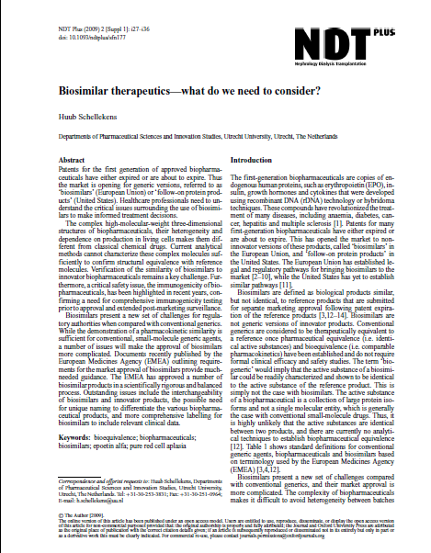
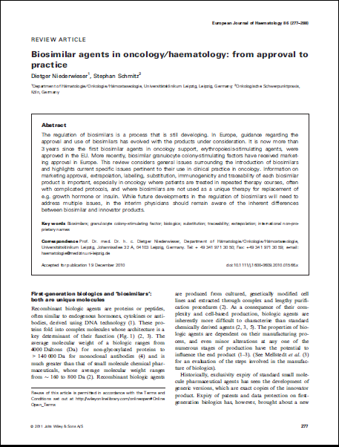
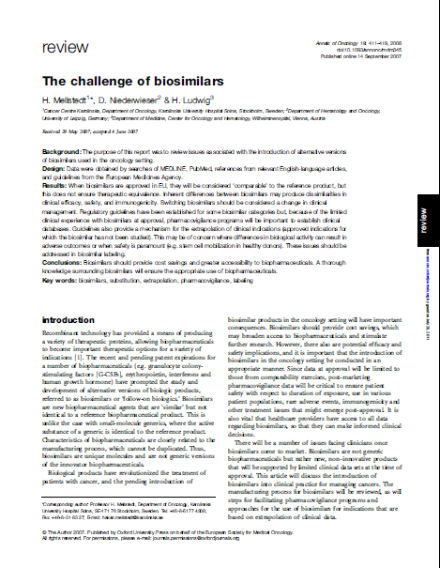
Questions initially raised over the use of biosimilars
What’s a biosimilar ?
Traceability
Quality of product
Are biosimilars safe and efficacious ?
Immunogenicity

Slide 3
Questions initially raised over the use of biosimilars
What’s a biosimilar ?
Traceability
Quality of product
Are biosimilars safe and efficacious ?
Immunogenicity

Slide 4
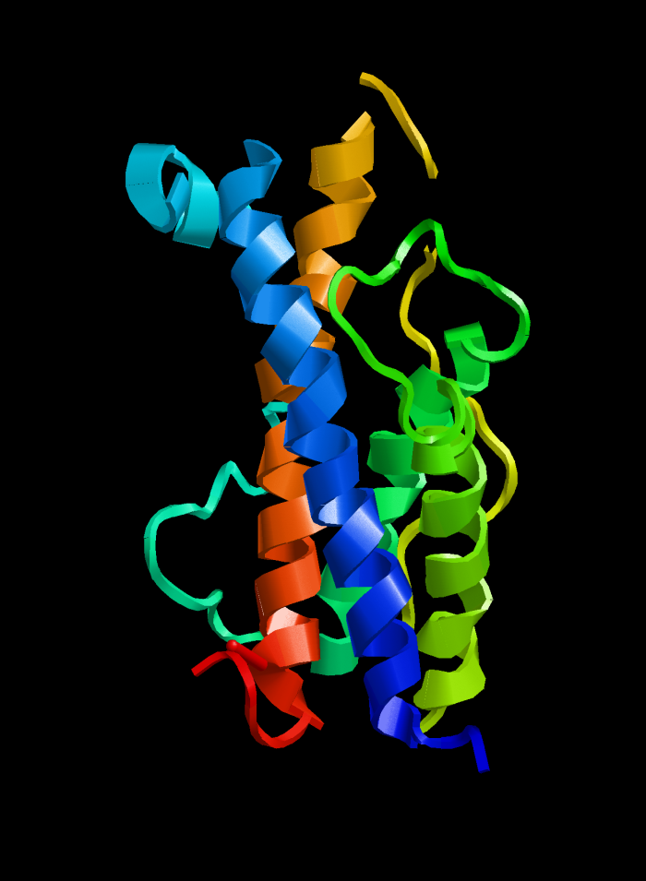
What is a Biosimilar or Follow-on Biologic?
A biosimilar medicinal product is a successor to a biological medicinal product for which patent protection no longer applies
Manufactured by recombinant DNA technology (insertion of gene into the host cell to produce the protein)
Comparable with the selected reference product/comparator biodrug in terms of quality, safety and efficacy
Not simple generics due to complexity : size, structure and manufacturing
Biosimilar is a EMA regulatory term describing a biologic that has been approved via a stringent pathway demonstrating comparability
Consensus Information Paper 2013. What you need to know about Biosimilar Medicinal Products
Notes:
4

Slide 5
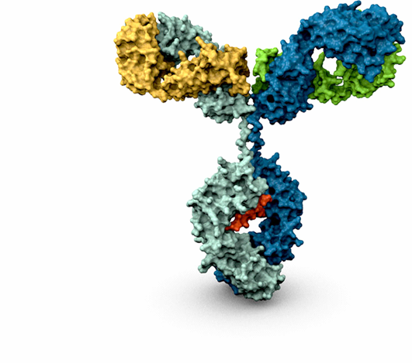


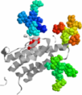
Biologics are more complex than small molecules…
Chem.Synthesis
Bacteria, Yeast
Mammalian
e.g. salicylate drugs,
antibiotics
Peptide
protein
Protein
(no sugars)
protein
Glycoprotein
(with sugars)
1x
19x
105x
122x
170x
833x
0 a.a.
32 a.a.
175 a.a.
191 a.a.
166 a.a.
~1300 a.a.
aspirin
0.18kDa
calcitonin ~3.5 kDa
filgrastim ~19 kDa
somatropin
~22 kDa
epoetin ~30 kDa
Monoclonal antibody
~150 kDa
Consensus Information Paper 2013. What you need to know about Biosimilar Medicinal Products

Slide 6
The Biosimilar approval pathway has a clear legal framework from EMA
1
2
Legal basis
EMA guidelines
The legal framework: EU Directive 2001/83/EC, Article 10, Paragraph 4, in EU Directive 2004/27/EC, implemented in October 2005
The requirements are in EU Directive 2003/63/EC, Annex, Part II, Point 4, for “Similar Biological Medicinal Products”
General guidelines for biopharmaceuticals
Quality issues
Non-clinical
Clinical
Immunogenicity
Product-specific guidelines
Erythropoietins
Somatotropin
GCSF
Insulin
Interferon alpha
LMWH
Biosimilar
approval
pathway
has a clear
legal basis

Slide 7
Proof of comparability utilising collective body of evidence
PAC
Phase IV / PASS studies
Safety profile and efficacy shown in 1 or 2 phase 3 in sensitive indications
Clinical
Clinical
Efficacy shown in healthy volunteers – phase I
PK / PD
PK / PD
COMPARABILITY
In vitro pharmacology and preclinical studies
Dosing and tolerability demonstrated
In vitro pharmacology and preclinical studies
Biological quality assessment
In vivo assay and in vitro testing demonstrates biological characterisation
Biological quality assessment
Demonstration of structure at protein and carbohydrate levels
Comprehensive molecular analysis
Comprehensive molecular analysis
Physical characterisation
Consensus Information Paper 2013. What you need to know about Biosimilar Medicinal Products

Slide 8
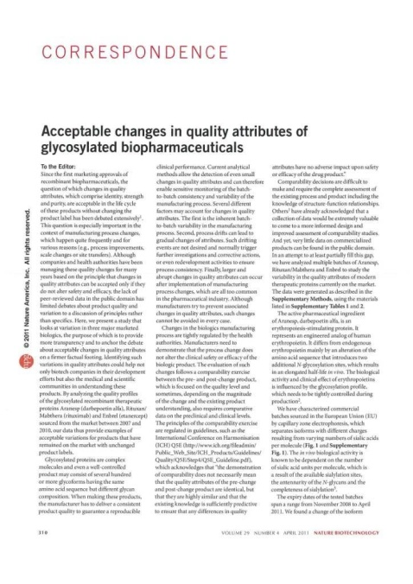
Originator variability is the basis for the biosimilarity goal posts...
Post-Shift
Shift in glycosylation (structure) pattern of an approved mAb results in different potency in cell-based assays (function)
Indication of a change in the manufacturing process
Such shifts observed in several original products
Products found to be equally safe and effective post-shift by regulators (EMA, FDA)
Pre-Shift
Post-Shift
Schiestl, M. et al., Nature Biotechnology 29, 310-312, 2011)
Pre-Shift

Slide 9
Questions initially raised over the use of biosimilars
What’s a biosimilar ?
Traceability
Quality of product
Are biosimilars safe and efficacious ?
Immunogenicity

Slide 10
Traceability
Biosimilars generally have same INN as reference product
Prescribe by brand name to allow traceability > pharmacovigilance
Sandoz Biosimilars have distinct brand names
EMA states “the specific medicinal product given to the patients should be clearly identified”
Sandoz as other EU companies have formal pharmacoviligence departments with regular safety reporting to EMA
Consensus Information Paper 2013. What you need to know about Biosimilar Medicinal Products

Slide 11
Questions initially raised over the use of biosimilars
What’s a biosimilar ?
Traceability
Quality of product
Consistent efficacy and safety
Immunogenicity

Slide 12



Development approach for biosimilars is closer to originators than generics
Generics*
Biosimilars*
Originators*
US$ 2 – 3m
US$ 150 – 250m
US$ 800m
Development investment
2 – 3 yrs
7 – 8 yrs
8 – 10 yrs
Time to market
20 – 50 pts
~ 500 pts
800 – 1000 pts
# of patients for approval¹
* Industry average
Consensus Information Paper 2013. What you need to know about Biosimilar Medicinal Products
Notes:
12
This slide shows that biosimilars, while related to generics to the extent that they are also marketed following loss of patent protection for their reference products, are otherwise closer in many ways to branded pharmaceuticals.
This is reflected also in the fact that Sandoz Biopharmaceuticals is organized as a separate business unit within Sandoz, with a separate (though related) branding and corporate identity.
The timelines given are a mixture of internal and external (including competitor) estimates, and should not be described as specific to Sandoz.
The patient number estimates are based on the footnoted assumptions (i.e. they are in no way typical of numbers in other therapeutic areas, such as CVM).

Slide 13
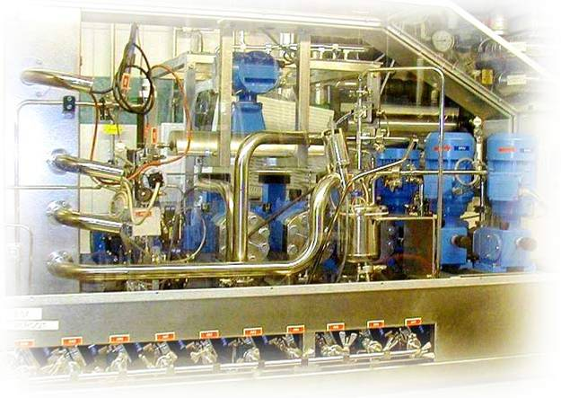

Quality standards in manufacturing apply equally to all biopharmaceuticals including biosimilars
Cell banks
Purification
Seed cultures
Fill & Finish
Fermentation
Storage & Transport
Harvesting
Consensus Information Paper 2013. What you need to know about Biosimilar Medicinal Products
Notes:
13

Slide 14

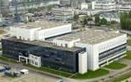

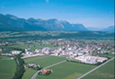
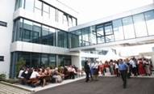
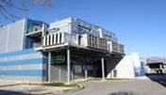
Sandoz, a Novartis company with state-of-art in-house manufacturing facilities
Vacaville (California)
Microbial production
Huningue (France)
Cell culture production
Basel (Switzerland)
Product development
Cell culture production
Kundl (Austria)
Tech. development
Regulatory affairs
Microbial production
Holzkirchen/ Oberhaching (Germany)
BU management
Clinical development
Clinical safety
Pharmacovigilance
Menges (Slovenia)
Tech. development
Cell culture production

Slide 15

All methods can contribute to demonstrating similarity beyond the main components
Primary structure e.g.:
LC-MS intact mass
LC-MS subunits
Peptide mapping
Higher order structure e.g.:
NMR
CD spectroscopy
FT-IR
Impurities e.g.:
CEX, cIEF acidic/basic variants
LC glycation
Peptide mapping deamidation,
oxidation, mutation, glycation
SEC/FFF/AUC aggregation
Post translat. modif. e.g.:
NP-HPLC-(MS) N-glycans
AEX N-glycans
MALDI-TOF N-glycans
HPAEC-PAD N-glycans
MALDI-TOF O-glycans
HPAEC-PAD sialic acids
RP-HPLC sialic acids
Biological activity e.g.:
Binding assay
ADCC assay
CDC assay
Combination of attributes e.g.:
MVDA, mathematical algorithms
Consensus Information Paper 2013. What you need to know about Biosimilar Medicinal Products
Notes:
15
Total global revenue of top 10 drugs in 2016: USD 70.6 bn
Total global revenue of top 20 drugs: USD 105.9 bn
10 of the top 20 pharmaceuticals will be biologics

Slide 16
Peptide mapping
No additional and no missing peptides were detected
Identical primary amino acid structure and disulfide bridging
Biosimilar G-CSF
Neupogen®
140
120
100
80
60
40
20
0
02+03
02+03
07
07
01
01
04 (2-2)
04 (2-2)
05
(1-4)
02
011
05
(1-4)
06
011
06
09+010
04
012
09+010
012
mAU
0 5 10 15 20 25 30 35
Min
Sorgel F et al. Biodrugs 2010;24 (6) : 347-357
Notes:
Peptide mapping
Peptide mapping enables determination of the protein sequence down to the level of single amino acids. Proteins were digested using an endoproteinase and the peptides obtained were separated using reversed phase chromatography, detected by UV-absorption and identified by online electrospray ionization mass spectrometry.
The identity of the product in the test samples was confirmed by comparing the peak profile to that obtained from the reference product Neupogen®, taking into account the number of detected peaks, retention times, and peak areas of the individual peaks.

Slide 17
Nuclear magnetic resonance spectra
Biosimilar G-CSF
Neupogen®
Relative intensity
Relative intensity
11 10 9 8 7 6 5 4 3 2 1 0 -1
11 10 9 8 7 6 5 4 3 2 1 0 -1
ppm
ppm
NMR spectrum can be considered a structural fingerprint of the protein
EP-2006 shows similar NMR spectrum as Neupogen®
Demonstrates comparable secondary and tertiary structure
Sorgel F et al. Biodrugs 2010;24 (6) : 347-357
Notes:
Nuclear magnetic resonance spectroscopy (NMR) is a powerful technique for determining the 3D structure of biological macromolecules. It measures chemical shifts of particular spins that report information on the electronical environment of specific groups of a molecule. In a protein molecule, the individual electronical environment of every proton is a direct consequence of the unique 3D-fold of the protein. A NMR spectrum can be considered as a structural fingerprint of the protein. An important application of NMR is in studies of proteins produced and purified from different sources. NMR is a very efficient and highly reliable method in checking the folding of proteins.
The spectra of all the tested samples exhibit NMR signal dispersions between 10.0 and 0.0 ppm indicating a fully folded protein.
No shift or broadening of signals was found and the peak patterns corresponded to a very high degree.
These data show the identity of the overall tertiary fold of the tested batches of Zarzio® and Neupogen® and show the structural equivalence of Zarzio® and Neupogen®.

Slide 18
Determination of receptor binding: Surface plasmon resonance spectroscopy
80
60
40
20
0
-20
rel. response (RU)
1 nM EP2006 #48200403
1 nM EP2006 #48200404
1 nM EP2006 #48200405
1 nM Neupogen #N1113AG
1 nM Neupogen #N1144AE
1 nM Neupogen #N1114AJ
0
200
400
600
800
1000
1200
1400
time (s)
Association rate
Disassociation rate
Kinetic rate constants (k_{on} and k_{off}) similar for EP2006 and Neupogen®
No difference in equilibrium dissociation constant (KD)
EP2006 and Neupogen® show highly comparable affinity for G-CSF receptor
Sorgel F et al. Biodrugs 2010;24 (6) : 347-357
Notes:
Surface plasmon resonance spectroscopy
The interaction of both Zarzio® and Neupogen® with the G-CSF receptor GCSFR/CD114 was investigated. Surface plasmon resonance allows the affinity of the protein for the receptor to be measured by the determination of both the k_{on} rate and the k_{off} rate. These rates are directly related to the structure of the binding region of the molecule.
To analyse the affinity of G-CSF to the receptor, a surface plasmon resonance (SPR)-based interaction assay was developed using Biacore technology. The assay was used to compare interaction characteristics of three individual lots of Zarzio® to three individual lots of Neupogen®.
Kinetic analysis of three batches of Zarzio® and three Neupogen® samples was performed head-to-head. In all cases, no significant difference could be detected with respect to the kinetic rate constants k_{on} and k_{off}, or the equilibrium dissociation constant, KD.
In summary, no significant difference between Zarzio® and Neupogen® could be detected. Comparable affinity to the receptor was shown for both products.

Slide 19
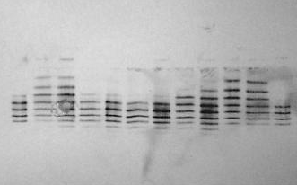
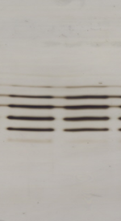
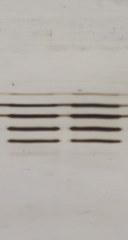
Non-comparable “copy biologics” – not approved in highly regulated markets – are NOT biosimilars
Isoelectric focusing gels
Non-comparable “copy biologic” ≠ biosimilar
Approved biosimilar in EU
NOT similar to Reference E
NO difference to originator
Sample E IA IB IIA IIB IIIA IIIB IV V VII VIII E
Sample
1
2
3
4
Schellekens H et al. Eur J Hosp Pharm Pract 2004;3:43–7
Brockmeyer C & Seidl A et al. Eur J Hosp Pharm Pract 2009;15:34–40

Slide 20
Quality Attributes Demonstrated
Biosimilar ESA HX575
Biosimilar G-CSF EP2006
Absence of dimers or aggregates in drug substance or drug product
Low amount of product related variants
Low content of oxidised methionine in lower strengths (16.8 µg/mL)
Low amount of impurities
Low content of silicon oil
Shelf-life of 30 months
Low batch-to-batch variation
Extended out of fridge of 72 hrs
Extended shelf-life of 24 months
Binocrit® European Product Assessment Report – 13 Sept 2007 - Scientific Discussion
Binocrit® SPC 18/04/2011, Sorgel et al Biodrugs 2010, Zarzio SPC 12/08/2011

Slide 21
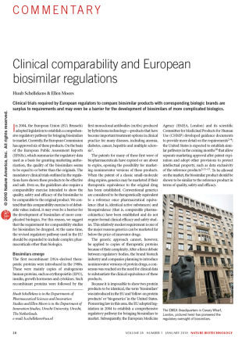
Modern generation Biosimilar manufactured using state-of-the-art technology
‘According to the EPARs, the biosimilar epoetin alfas and one of the biosimilar filgrastims have fewer impurities and less modified product than their reference products. We have recently analysed the physical chemical characteristics of both biosimilar epoetins and have found the quality of these biosimilars to exceed the original product’
‘Since the introduction of the first recombinant DNA-derived therapeutic proteins, the technology to produce and purify these products has greatly improved. Biosimilar manufacturers are consequently using state-of-the-art technology; in contrast, brand manufacturers of the original products are often locked into old technologies because changing methods has major financial and regulatory consequences. With this in mind, it seems much more logical for regulators to expect biosimilars to be produced by the best technology on offer rather than to mandate that they are of comparable quality to the brands’
Schellekens et al. Nat Biotech 2010; 28: 28-31

Slide 22
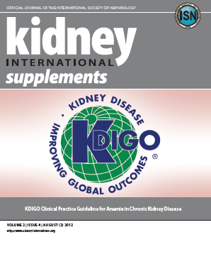
Latest Global Nephrology Anaemia KDIGO guidelines recognise EMA biosimilar approved ESAs
KDIGO 2013 Guidelines

Slide 23
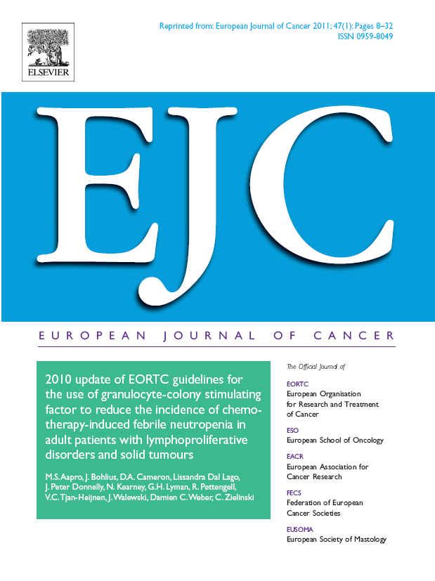
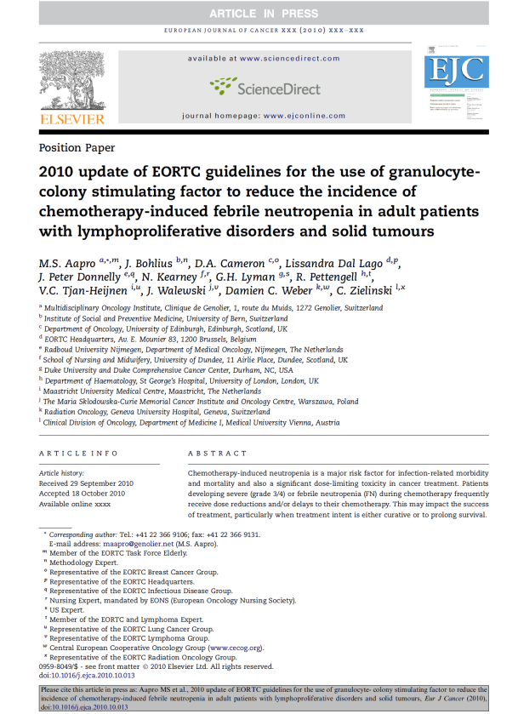
Latest EORTC 2010 G-CSF Guidelines Recognise Biosimilar G-CSFs as a treatment option in Europe
6 | Filgrastim, lenograstim and pegfilgrastim have clinical efficacy and we recommend the use of any of these agents, according to current administration guidelines, to prevent FN and FN-related complications, where indicated. Filgrastim biosimilars are now also a treatment option in Europe. | A
Aapro MS et al EJC 2011

Slide 24
Questions initially raised over the use of biosimilars
What’s a biosimilar ?
Traceability
Quality of product
Are biosimilars safe and efficacious ?
Immunogenicity

Slide 25
Summary of experience from clinical development studies for Biosimilar HX575 and EP2006
Clinical safety & efficacy
Clinical
COMPARABILITY
In vitro pharmacology and preclinical studies
Physical characterisation

Slide 26
Biosimilar Epo alfa Phase 3 in Nephrology : Comparable Hb levels and epoetin dose for the study duration
Long-term development of Hb levels and epoetin dosage
ITT group excluding protocol violators*
Mean Hb (g/dL)
Mean Epoetin dosage (IU/week)
15
14
13
12
11
10
9
8
18000
16000
14000
Biosimilar n = 314
Eprex n = 164
12000
10000
8000
6000
4000
Dosage of Biosimilar
Eprex®
Hb on Biosimilar
Hb on Eprex®
2000
Part I (HX575 or reference product)
Part II (HX575 only)
0
Scr/bas.
period
4
8
12
16
20
24
28
32
36
40
44
48
52
56
Study week
Adapted from Haag-Weber et al. Clin Nephrol 2009; 72: 380-90
Mean levels. Excludes protocol violators.
*This subpopulation excludes those patients who did not receive dosing according to protocol.

Slide 27
Phase 3 Nephrology : safety profile of Biosimilar ESA HX575 consistent with that of Eprex®
Events per patient-year exposure
16
338.4 patient years exposure to Biosimilar ESA, 81.6 patient-years exposure to Eprex®
Comparable safety profiles
No neutralising anti-epoetin antibodies were detected
12
8
4
0
Adverse events
Serious adverse events
Drug-related adverse events
Biosimilar ESA
Eprex®
Haag-Weber et al. Clin Nephrol 2009; 72: 380-90

Slide 28
Phase 3 in Oncology : similar Hb correction demonstrated for Biosimilar ESA HX575 and Eprex®
Hb concentration over time (Study INJ-11)
Haemoglobin (g/dL)
14
13
12
11
10
9
8
7
6
5
4
3
2
1
0
Efficacy Parameter | Biosimilar ESA | Eprex®
Mean Hb increase (g/dL) | 1.9 | 1.9
Transfusions (%) | 32 | 38
Dose increase (%) | 47 | 56
Biosimilar ESA
Eprex® (n=34)
(n=60)
-2 0 2 4 6 8 10 12
Study week
Weigang-Köhler et al. Onkologie 2009; 32: 168-74

Slide 29
Phase 3 in Oncology : safety profile of Biosimilar ESA HX575 consistent with that of Eprex®
% patients
100
80
Comparable safety profile
No anti-epoetin antibodies were detected
60
40
20
0
Adverse events
Serious adverse events
Drug-related adverse events
Biosimilar ESA
Eprex®
Weigang-Köhler et al. Onkologie 2009; 32: 168-74

Slide 30
Biosimilar G-CSF EP2006 Phase I: Study EPO6-103 PD results for 5 µg/kg
Development of absolute neutrophil count (ANC)
Development of CD34⁺ cells
60
Biosimilar G-CSF EP2006
80
Neupogen®
Biosimilar G-CSF EP2006
50
70
Neupogen®
60
40
50
ANC (10³/µL)
CD34+ (/µL)
30
40
20
30
20
10
10
0
0
0
20
40
60
80
100
120
140
160
180
200
220
0
20
40
60
80
100
120
140
160
180
200
220
Time after administration (h)
Time after administration (h)
Dose: 5 µg/kg SC for 7 days
Curves for both ANC and CD34⁺ cells highly comparable for Biosimilar G-CSF EP2006 and Neupogen®
Gascon P et al. Ann Oncol, Dec 09

Slide 31
Phase I: Study EPO6-101 PD results for 10 µg/kg
Development of absolute neutrophil count (ANC)
Development of CD34⁺ cells
100
Biosimilar G-CSF EP2006
®
80
Biosimilar G-CSF
®
80
Neupogen®
70
Neupogen®
60
60
50
ANC (10E3/µL)
CD34+ (/µL)
40
40
30
20
20
10
0
0
0
20
40
60
80
100
120
140
160
180
200
220
0
20
40
60
80
100
120
140
160
180
200
220
Time after administration (h)
Time after administration (h)
Dose: 10 µg/kg SC for 7 days
Curves for both ANC and CD34⁺ cells highly comparable for EP2006 and Neupogen®
Gascon P et al. Ann Oncol 2009, doi: 10.1093/annonc/mdp574

Slide 32
Confirmatory clinical study in 170 breast cancer patients
20
Mean ANC by cycle and day
Safety data for EP2006 were consistent with the well-known safety profile of the G-CSF class:
21% incidence of musculoskeletal pain (8.8% bone pain) with EP2006 is in line with incidence reported with Neupogen®
Good local tolerability
None of the patients developed anti-G-CSF antibodies at any point during the study
Cycle 1
Cycle 2
15
Cycle 3
Cycle 4
ANC (x 10⁹/L)
10
5
Typical to see lowest nadir following cycle 1
0
1
2
3
4
5
6
7
8
9
10
11
12
Day of cycle
ANC : Healthy 3-5 x 10⁹, grade 4 CIN 0.5 x 10⁹, grade 3 CIN 1 x 10⁹, grade 2 CIN 1.5-1 x 10⁹
Gascon P et al. Ann Oncol Dec 09
Notes:
Mean ANC curves were congruent for all cycles from day 1 to day 11. As expected, the depth of the ANC nadir was greater in cycle 1 compared with the subsequent three cycles.

Slide 33
Post-Approval Studies
PMS
Phase IV studies
Clinical safety & efficacy
COMPARABILITY
In vitro pharmacology and preclinical studies
Physical characterisation

Slide 34
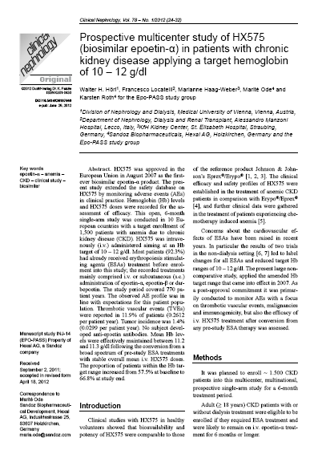
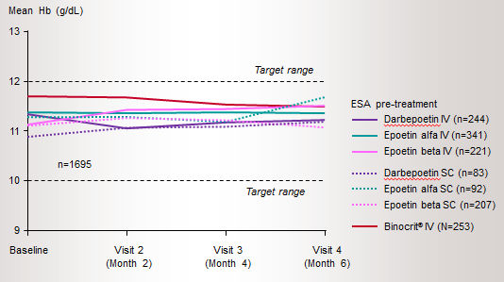
Biosimilar ESA HX575 study in 1697 haemodialysis patients (EPO-PASS)
EMA Commitment HX575 studied in 1697 HD patients for 6 months switched from various ESAs (inc Darbepoetin,Eprex,NeoRecormon)
9.3% increase in Hb stability (Hb 10-12 g/dl)
Non-significant 5% increase in ESA dose requirement from IV ESAs
Only 13% dose increase following switch from SC ESAs
No unexpected side-effects
No anti-epoetin antibodies
Hoerl W, Locatelli F Clinical Neph 2012

Slide 35

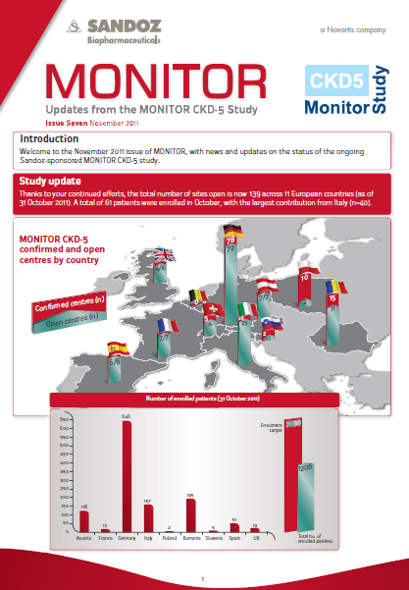
Biosimilar ESA HX575 study in 2100 haemodialysis patients (Monitor CKD-5)
Pan-European Epidemiology
170 dialysis centres, 11 EU countries
2100 patients with 2 year follow-up
Outcome and practice patterns study
Efficacy and safety
Interim data presented at EDTA 13
Gesualdo L et al 2011 Internal Emerg Med

Slide 36
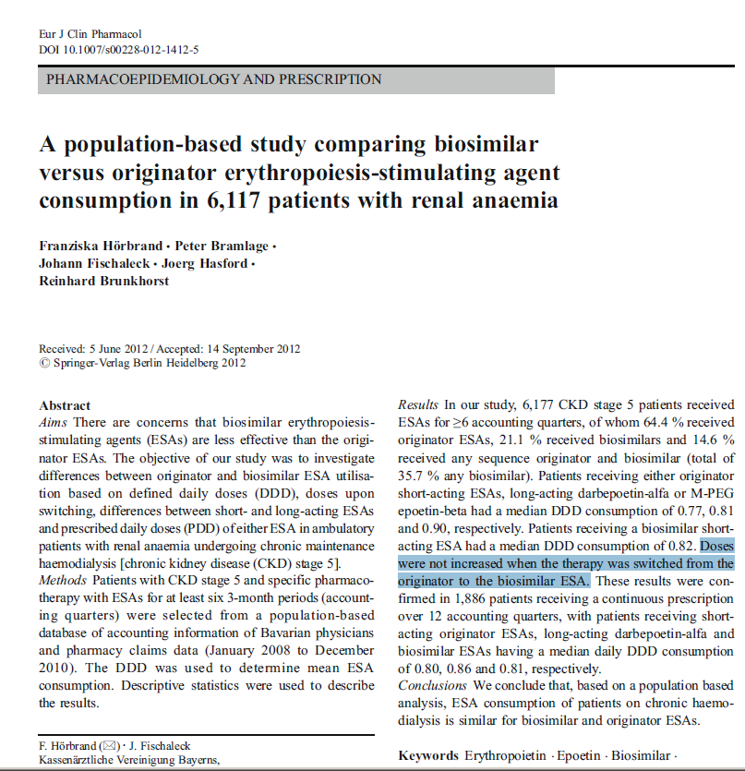
Drug Utilisation of Biosimilar ESAs and originators in Bavarian Haemodialysis Population (n=6117)
„Doses were not increased when the therapy was switched from the originator to the biosimilar ESA.”
Consumption was similar for biosimilar and originator ESA.
Horbrand et al Eur J Clin Pharmacol. 2013 Apr;69(4):929-36

Slide 37
Biosimilar ESA HX575 : Retrospective clinical experience Patients (n=152) with solid tumours
Response rate (% of patients)
Hb increase ≥1 g/dl in 4 weeks or achieving 10-12 g/dL during study
Binocrit® 30000 IU/week and 40000 IU/week were comparable
Addition of IV iron leads to enhanced Hb response
p=ns
p<0.05
30000 IU/week
40000 IU/week
With IV Fe
Without IV Fe
Kerkhofs L et al. Future Oncol 2012; 8: 751–6

Slide 38
Biosimilar ESA HX575 : OnCoBos ongoing PMS umbrella with >3000 CIA patients
France : 2000 patients planned, 100 sites, currently 1057
Romania : 710 patients planned, 90 sites, currently 275
Austria : 60 patients ongoing, 6 sites,.
Germany : 400 patients planned, 100 sites,
Spain : 150 patients planned, 10 sites
Italy : 300 patients ongoing, 30 sites
First interim data outputs : MASCC & ESMO 2013

Slide 39
OncoBOS (France) observational study: real-world effectiveness and safety of Binocrit®
Mean Hb (g/dL)
Ongoing, prospective, multicentre study of Binocrit® for the treatment of CIA
Hb outcomes from 444 patients with solid tumours, lymphoma or myeloma
Significant increase in mean Hb level at Week 12 versus Week 0
The required dose of Binocrit® remained stable over the treatment period
14
*p<0.001 vs W0
12
11.2*
10.6
10
9.6
8
6
4
2
0
W0
W3–4
W12
Fayette et al. Poster presented at the MASCC/ISOO 2013 Congress, Berlin, June 27–29

Slide 40
OncoBOS (France) observational study: real-world effectiveness and safety of Binocrit®
Chemotherapy dose alterations at Week 12
 | N=412
Modification of chemotherapy | Yes | 77 (18.7%)
 | No | 335 (81.3%)
Dose reduction | Yes | 28 (6.8%)
 | No | 384 (93.2%)
Delays | Yes | 48 (11.7%)
 | No | 364 (88.3%)
81.3% of patients were able to continue chemotherapy without dose delays or reductions
Fayette et al. Poster presented at the MASCC/ISOO 2013 Congress, Berlin, June 27–29

Slide 41
OncoBOS (France) observational study: real-world effectiveness and safety of Binocrit®
Summary of adverse events
 | No. of patients (%) | No. of events
Adverse events | 102 (23) | 177
Serious adverse events | 51 (11.5) | 68
Emergent adverse events | 67 (15.1) | 112
Emergent serious adverse events | 24 (5.4) | 30
Adverse drug reactions | 3 (0.7) | 3
Fayette et al. Poster presented at the MASCC/ISOO 2013 Congress, Berlin, June 27–29

Slide 42
Biosimilar G-CSF EP2006 Patients studied PMS
Studies (Dec ‘12) : >3500 in addition to Phase III
Monitor G-CSF
Pan-European epidemiology study in CIN
1534 patients, 190 hospitals, prospective, pan-European. Key objective: practice patterns vs. outcomes. Status – on-going (currently 1534 pts.)
Hexafil
Post-Marketing Surveillance CIN
1500 patients, >75 hospitals, prospective, Germany. Status – completed
ZOS
Post-Marketing Surveillance CIN
201 patients, 16 hospitals, prospective, France. Status – completed
Hospital
Experience
Rosati, Verpoort, Salesi CIN switch data
Various tumour types. 167 patients observed

Slide 43
Patients/ healthy donors studied in transplantation
(Hospital experience and commitment study)
Lefrere : 40 autologous biosimilar GCSF Vs 41 matched historical cohort Neupogen Advances in Therapy 2011
Dymosynzska : 108 autologous patients, RCT biosimilar GCSF Vs Neupogen. EBMT 2012
Kotwica : 23 patients treated with biosimilar GCSF post-BMT. EBMT 2012
Czerw : 55 patients biosimilar GCSF Vs 35 Neupoigen post-BMT. EBMT 2012
Yafour : 20 patients biosimilar GCSF Vs Neupogen autologous. EBMT 2012
Zabalza : 72 patients treated with biosimilar GCSF autologous . EBMT 2013
Gopsca : 70 patients treated with biosimilar GCSF autologous EBMT 2013
Ostuni : 44 patients treated with biosimilar GCSF autologous EBMT 2013
Yafour : 98 patients treated with biosimilar GCSF Vs Neupogen EBMT 2013
Stem Cell
Autologous
N = 530
Stem Cell
Allogeneic
N=126
Azar : 24 related healthy donors treated with biosimilar GCSF . EBMT 2012
Becker + Bronig : 84/200 unrelated healthy donors treated with Zarzio. EBMT 2013 (oral presentation)
Antelo : 18 related healthy donors (9 biosimilar GCSF Vs 9 Neupogen). EBMT 2013

Slide 44
Questions initially raised over the use of biosimilars
What’s a biosimilar ?
Traceability
Quality of product
Are biosimilars safe and efficacious ?
Immunogenicity

Slide 45
Full validated antibody tests
Radio-Immuno-Precipitation assay (RIP)
Neutralising Antibody Assay (NAB)
Cross-reference with external lab (Paris) fir any positive NABs
Used throughout Sandoz clinical development programmes
No positive NABs to date with Biosimilar ESA (IV) and Biosimilar G-CSF
Regular formal PSURs to EMA
Sandoz data on file 2013; HX575 PSUR Feb 2013 ; EP2006 Jan 2013 PSUR
Notes:
For my last discussion point – immunogenicity – a large concern raised by the community at the advent of biosimilars – mainly due to the incidence of PRCA which occurs across the ESA class in Nephrology

Slide 46





















Biosimilar ESA HX575 and G-CSF EP2006 : currently launched in >40 in EU and non-EU countries
Significant Usage in Europe over 7 years
Biosimilar ESA HX575 : Current estimated exposure: >200,000 patient-years (Mar 2013)
Biosimilar G-CSF EP2006 : Current estimated exposure: >3.5 million patient-days (Jan 2013) and now number 1 short acting G-CSF in Europe
Safety profile consistent with G-CSF and ESA-class and no reports of neutralising antibodies with commercial product
Sandoz data on file 2013; HX575 PSUR Feb 2013 ; EP2006 Jan 2013 PSUR

Slide 47
Key questions initially raised over the use of biosimilars
Can the savings be realised due to cost of development
Notes:
For my last discussion point – immunogenicity – a large concern raised by the community at the advent of biosimilars – mainly due to the incidence of PRCA which occurs across the ESA class in Nephrology

Slide 48
EPO Biosimilar in Germany resulted in €60m annual savings (–17.3%) in 1st year on market
EPO market in Germany: Effect of biosimilar market entry¹
€ millions
Total projected savings in Germany from biosimilars of € 8 billion through 2020
€ 60m savings from price reductions
Market before biosimilars
Biosimilar price reduction
Originator price reductions
Market w/biosimilars
Additional without restricted access
Potential mkt size
¹Source: IGES Institute. The Competitive Role of Biosimilars in the German SHI Market for Pharmaceuticals

Slide 49
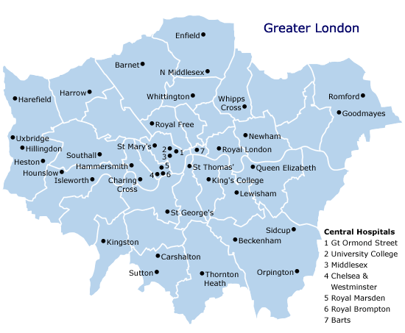
Savings attributable to high uptake of biosimilar G-CSF in Europe
Predicted annual savings 2012 achieved by London hospitals after switch to Zarzio®
Estimated annual savings to European healthcare system in 2011
£2 000 000
(€ 2 450 000)
€85 000 000
Internal Sandoz Sales & Units sold in 2010 / 2011 in 17 EU Markets and originator (Neupogen) public prices. Analysis includes savings from discounts / rebates provided by Sandoz without knowledge of historical discounts from originator.

Slide 50

Biosimilars expand patient access :
UK G-CSF example
UK G-CSF volume growth
Percent change vs. previous year
G-CSF prevents hospital re-admission due to infection
More physicians start G-CSF treatment earlier (primary prophylaxis) due to more affordable cost
Sept. 2008 biosimilars approved by EMA
2007
2008
2009
2010
2011
Source: IMS, NHS
Notes:
50

Slide 51
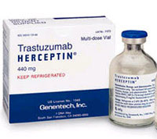
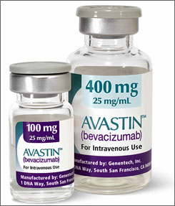
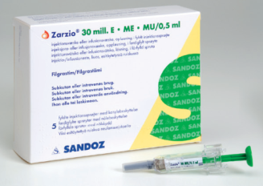
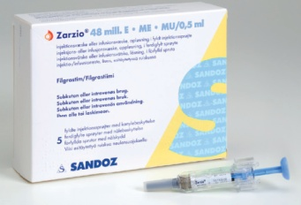
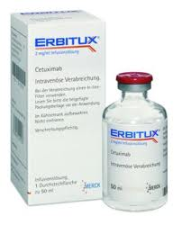
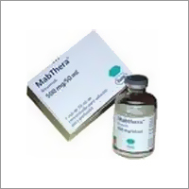
Savings for biosimilars may be reallocated to
other vital medicines
Illustrative
Biosimilars
Metastatic Breast Cancer patients
Colorectal Cancer patients
Head & Neck Cancer patients
Non Hodgkin's Lymphoma patients

Slide 52

The vast majority of EMA markets accept the filgrastim biosimilar concept however several lag behind
Biosimilar penetration vs. reference product Neupogen % standard units Feb 2013
Belgium
Ireland
Lithuania
Netherlands
Switzerland
Greece
Germany
Italy
Spain
Slovenia
Denmark
France
EU Average
Finland
Austria
Poland
Slovakia
Sweden
Bulgaria
Norway
UK
Czech Republic
Hungary
Romania
Latvia
Note: Biosimilar filgrastim includes Zarzio, Filgrastim-Hexal, Nivestim, Tevagrastim/Ratiograstim; Includes only reference product filgrastim
Source: IMS MIDAS, Feb 2013 Standard Units

Slide 53
When payers proactively engage the medical/clinical community real savings from biosimilars are possible
Best Practices
German KV Biosimilar EPO Quotas in combination with physician education and consultations - €551M saved 2007-2011
UK hospital G-CSF protocols have converted the market to biosimilars and enabled physicians to expand patient access
Hungary health system reforms: Biosimilar manufacturers and Generic Associations can be an agent of necessary fiscal sustainability
Recommendations for payers
Biosimilar quotas for retail based products – open communication from payers is key to alignment with prescribers
Payers must collaborate with KOLs in creating new treatment guidelines as it is critical to gain buy-in from physician community
Health reforms must be considered to facilitate uptake of biosimilars in achieving sustainable healthcare systems
Sandoz data on file 2013; HX575 PSUR Feb 2013 ; EP2006 Jan 2013 PSUR

Slide 54
Conclusions
√
What’s a Biosimilar ? – an EMA-approved comparable biologic
Traceability ? – clear packaging, prescribe by brand name
Quality of product ? – in-house modern technology
Consistent efficacy and safety ?
Immunogenicity ?
Cost savings ?
√
√
√
Estimated 100 million patient
days exposure for Sandoz
Biosimilars*
√
PSURs : biosimilar HX575 Feb 2013; biosimilar EP2006 Jan 2013 and biosimilar Growth Hormone Aug 2012

Slide 55
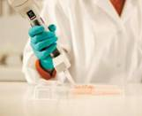
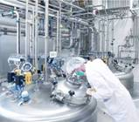
Sandoz Biopharmaceuticals is the leader in developing and manufacturing biosimilars
Biologics development and manufacturing experience:
66 years of experience in pharmaceutical biotechnology
32 years of experience in rec. therapeutic proteins
Extensive experience with novel biologics, from peptides to mAbs
In house development capabilities in the EU: Own labs for all key activities, ~600 associates in development, plus Novartis
In house manufacturing capabilities in the EU: Dedicated microbial (E. coli, yeast) and cell culture facilities, 8 API lines up to 40.000 L; plus fill & finish lines
Biosimilars expertise:
Pioneer – successfully developed 3 biosimilars worldwide
Broad pipeline with a focus on mAbs, multiple clinical trials ongoing (e.g. ph III rituximab, pegfilgrastim)
Sandoz data on file 2013; HX575 PSUR Feb 2013 ; EP2006 Jan 2013 PSUR
55
Notes:
55
55
55
Sandoz has referred previously to “about 25 projects“ in development. We now refer only to molecules and do not comment on the exact relationship between the two numbers.
Can also mention that manufacture approx. 25 originator products (both for Novartis and for third parties) – this is base of Sandoz biologics business. Generally do not name customers for competitive (and mutual agreement) reasons.

