Slide 1
ADR Monitoring and Reporting in Clinical Trials
Prof. Dr. Semra Sardas
Head of the Toxicology Dept. and
Drug Safety Unit
Marmara University-Faculty of Pharmacy
Istanbul-Turkey

Slide 2
The Ethical Imperative
‘‘The rights, safety and well- being of the trial subjects are the most important considerations and should prevail over the interests of science and society.’’
ICH-GCP [2,3]

Slide 3
Safety issues have an impact on:
study subjects at the site
all subjects in the trial
future recipients of product

Slide 4
The Importance of Safety Information
Safety issues also have an impact on the trial and the investigational product:
Amendments to the protocol may be made
The trial may be stopped
The risk/benefit profile may be reassessed
Dosing and indication may be altered
The product’s development may be reassessed

Slide 5
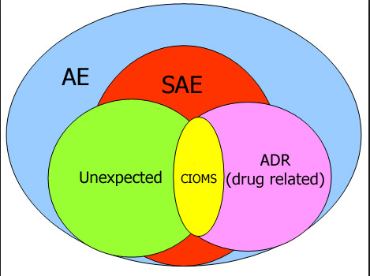
TERMINOLOGY
(Suspected Unexpected Serious Adverse Reaction- SUSAR)

Slide 6
Classification of AEs
AEs
Severity
Intensity of an AE
Mild, moderate, or severe
Relatedness
Relationship to product
Related or unrelated
Expectedness
Documented previously
Expected or unexpected
Seriousness (SAE)
Serious or not serious

Slide 7
Relatedness
An AE can be classified as…
unrelated
possibly related
definitely related
… to the investigational product
An AE should be classified as an ADR if a causal relationship between a medicinal product and an AE cannot be ruled out.

Slide 8
Expectedness of an AE
Expected AEs
Reported in previous clinical or preclinical trials
Described in IB/approved product information
Unexpected AEs
Not previously observed
Not consistent with information in IB/approved product information
You should be prepared for the occurrence of both expected and unexpected AEs

Slide 9
RESPONSIBILITIES

Slide 10
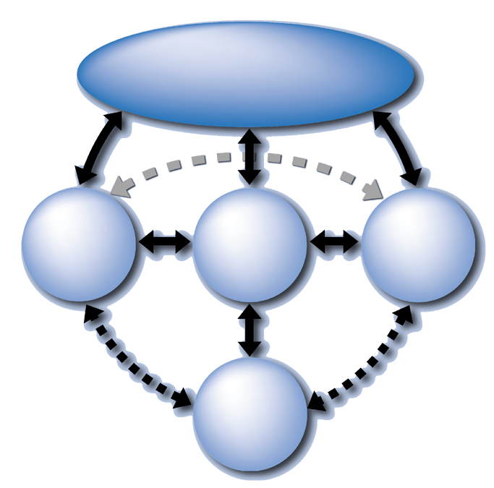
Partners in safety
Regulatory authorities
Investigator and study team
Sponsor
IRB/IEC
Subject
DSMB
Notes:
MOR!!

Slide 11
Responsibilities of the Investigator and Study Team
Before the trial begins
understand what is classed as an AE/SAE
familiarize yourself with the safety profile of the investigational product
familiarize yourself with all AE/SAE reporting procedures
know what to do when an AE/SAE occurs
understand which drugs and procedures may interfere with the investigational product, and which are permitted within the study
ensure that your study team is trained in identifying and reporting AE/SAEs.
%

Slide 12
During the trial :
review the protocol
encourage subjects to report all AEs
review, document and report all AEs
inform subjects of any new potential AEs
make the study team aware of new AEs
%

Slide 13
After the trial :
follow-up with subjects until stabilization
document and record subsequent AEs if related
AEs should be followed up and recorded in accordance with the protocol.

Slide 14
Responsibilities of the Sponsor
The sponsor…
‘‘… is responsible for the ongoing safety evaluation of the investigational product(s).’’
‘‘… should promptly notify all concerned investigator(s)/institution(s) and the regulatory authority(ies) of findings that could affect adversely the safety of subjects
ICH-GCP [5.16.1-2]
%

Slide 15
The sponsor must:
provide all safety information on the product
updated summary of product characteristics
obtain regulatory approval for the study
ensure that IRB/IEC approval is obtained before a study starts

Slide 16
Responsibilities of the IRB/IEC
‘‘ An IRB/IEC should safeguard the rights, safety and well-being of all trial subjects.’’
ICH-GCP [3.1.1]
All changes of the protocol
Changes increasing the risk to subjects and/or affecting significantly the conduct of the trial
All adverse drug reactions that are both serious and unexpected
ICH-GCP [3.3.8]

Slide 17
The Role of the Subject in the AE Reporting Process
discuss the occurrence of AEs with subjects
emphasize the importance of reporting all events
instruct the subject to disclose his/her trial participation if he/she receives emergency medical attention for any reason

Slide 18

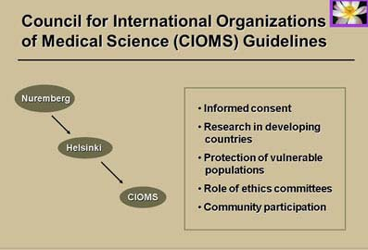
REPORTING ADVERSE EVENTS

Slide 19
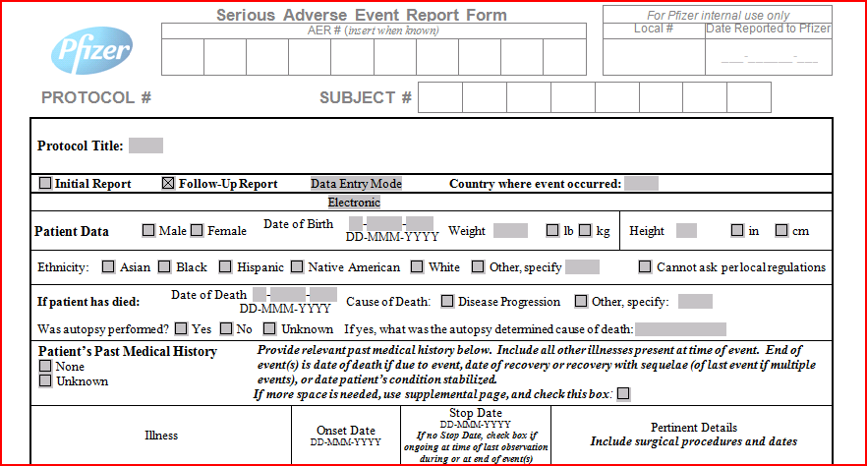
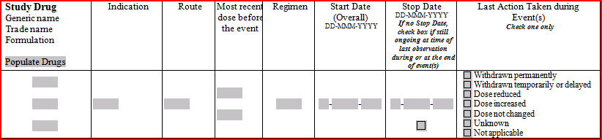

Slide 20
Considerations Regarding AEs
What to report
Where to report
Subject number/identifier
Severity
Duration
Changes
Causality
Seriousness
Expectedness
Subject notes/ source document,CRF
SAE form
How to report
Sponsor will provide direction
When to report
Timeframes differ for different types of events

Slide 21
SAE Reporting Requirements
‘‘ Investigator should report all SAEs immediately to the sponsor except for those SAEs that the protocol or other document (e.g., Investigator’s Brochure) identifies as not needing immediate reporting…
‘‘ … The sponsor sends the reports to the regulatory authority(ies) and IRB/IEC.’’
[ICH-GCP 4.11.1]

Slide 22
Data and Safety Monitoring Board
‘‘ An independent data monitoring committee that may be established by the sponsor to assess at intervals the progress of a clinical trial, the safety data and the critical efficacy endpoints and to recommend to the sponsor whether to continue, modify or stop a trial.’’
ICH—GCP [1.25]

Slide 23
Responsibilities of the DSMB:
Interim monitoring:
efficacy
safety
study conduct
external data
Making recommendations:
termination
protocol changes

Slide 24

Managing AEs
Notes:
Gönüllünün güvenliği hakları, ve esenliği dikkate alınacak en önemli husutur!!!

Slide 25
Managing AEs
Treat the subject
Know what treatments are contraindicated and what treatments would constitute protocol noncompliance
Only unblind if knowledge of treatment affects the management of event
Unblinding will generally lead to withdrawal of subject from the trial
Contact the sponsor before taking decision to unblind (where possible)
Document the event and the treatment provided
Report the event to the sponsor
Determine whether the subject should continue in the study

Slide 26
Drug Safety is the ongoing surveillance of product safety occurring throughout the product lifecycle.
After marketing, new safety information may become available:
– Through use of the product domestically or in other countries
– Through use of other drugs in the same class

Slide 27
Collecting Safety Data
Clinical Trials
Healthcare profes.
Before Approval
After Approval
Patients
National Registration
Authority
Drug Industry
International Safety
Database
Notes:
27

Slide 28
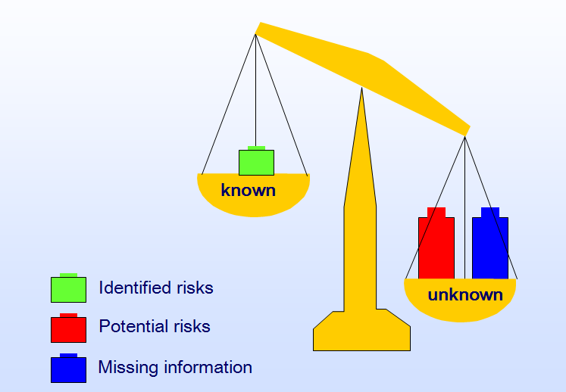
AT THE TIME OF APPROVAL

Slide 29
Why do we need ongoing surveillance?
At the time of approval, clinical trial data are available on limited numbers of patients treated for relatively short periods
Once a product is marketed, large numbers of patients may be exposed, including:
– Patients with co-morbid illnesses
– Patients using concomitant medications
– Patients with chronic exposure

Slide 30
Limitations of phase 1-3 clinical trials
Limited size: no more than 5000 and often as little as 500 volunteers.
Narrow populaton: age and sex spesific
Narrow indications: only the specific disease studied
Short duration: often no longer than a few weeks

Slide 31
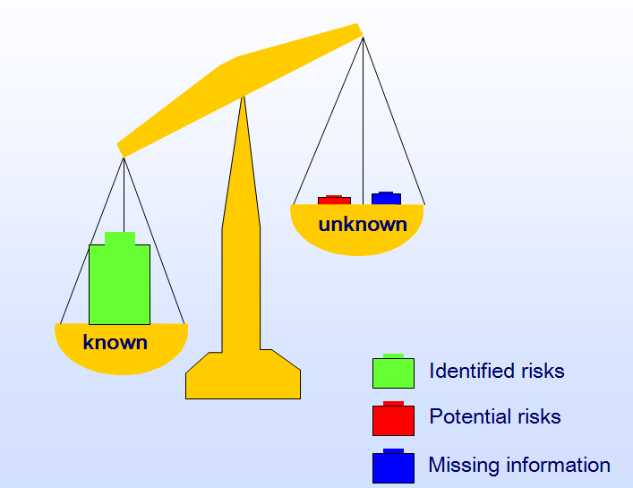
MATURE PRODUCT

Slide 32

semrasardas@gmail.com

