Slide 1


Reconstruction of the Pharmacovigilance System
Legal Changes 2010/2012
Izabela Słowik
Medical & Pharmacovigilance Affairs Director
EU QPPV of POLPHARMA Group

Slide 2
PRESENTATION PLAN
New Regulations „in pill”
Variation concerning the Pharmacovigilance system
New requirements concerning ICSR Reporting
New light for Risk Management /RMP
New „place” of Periodic Reports
Signal detection – the „growing importance”
Arbitration Procedure (related to safety concerns) – simplification
Post-authorisation Studies – new role

Slide 3
THE MAIN AIMS OF LEGAL CHANGES
increasing of the effectiveness of the pharmacovigilance system;
ensuring the transparency of the transmission of information, regarding decisions and its reasons;
increased of the participation of patients/caregivers in the pharmacovigilance;
effective use of available forces and means / to avoide of work duplication;

Slide 4
THE NEW LEGAL BASIS
Regulation (EC) No 726/2004
Regulation (EU) No 1235/2010
Directive 2001/83/EC,
Directive 2010/84/EU
Volume 9a “of The Rules Governing Medicinal Products in the European Union” and “Guidelines on Pharmacovigilance for Medicinal Products for Human Use” - September 2008
Good Pharmacovigilance Practise – Pharmacovigilance Modules Commission implementing regulation No 520/2012 of 19 June 2012 on the performance of pharmacovigilance activities provided for in Regulation (EC) No 726/2004 of the European Parliament and of the Council and Directive 2001/83/EC of the European Parliament and of the Council:

Slide 5
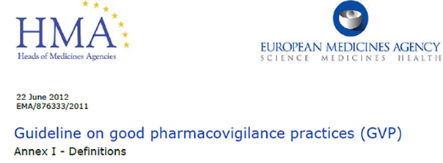
MUCH MORE CLEAR DEFINITIONS…..
1. Changes of definitions:
Adverse drug reaction - a response to a medicinal product which is noxious and unintended and which occurs at doses normally used in man for the prophylaxis, diagnosis or therapy of disease or for the restoration, correction or modification of physiological function
2. Supplementation of missing definitions:
Risk Management System
Risk Management Plan
Summary of the Pharmacovigilance System
Pharmacovigilance System Master File

Slide 6
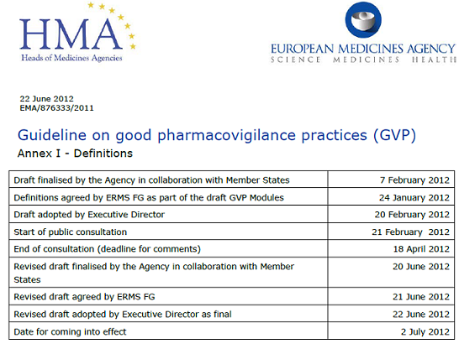
NEW SUBTYPES OF ADVERSE REACTION
– GVP DEFINITION
Definitions:
abuse
misuse
off-label use
overdose
occupational exposure
medication error
www.ema.europa.eu
www.hma.eu
Notes:
6

Slide 7
PREVIOUS REGULATIONS
The Detailed Description of the Pharmacovigilance System (DDPS) was required for submission as a part of the registration dossier (in the point 1.8.1.)
Any variations introduced into the description of pharmacovigilance system (DDPS) resulted submission of the post-authorisations variations.

Slide 8
NEW REGULATIONS:
Directive 2010/84/EC
The registration dossier in the point 1.8.1. contains only a Summary of Pharmacovigilance System (SPS) implemented by the company:
Summary of Pharmacovigilance System (SPS) should contain:
Confirmation that Marketing Authorisation Holder has the Qualified Person Responsible for Pharmacovigilance (QPPV) under disposal;
Permanent residence address and contact details of QPPV;
Statement that the Marketing Authorisation Holder has implemented the adequate system in order to fullfil all pharmacovigilance obligations stated in the directive;
Reference to the location of the Pharmacovigilance Master File.
Changes made within the SPS required post-authorisation variations.

Slide 9
NEW REGULATIONS:
Directive 2010/84/EC
Pharmacovigilance System Master File (PSMF)
Full description of the system is stored in the company's headquarters and it is available for Regulatory Authorities upon request;
Any changes or supplementations introduced to the PSMF usually does not result in the submission of post-authorisation variations;
NO template of PSMF has been proposed by the Regulatory Authorities
Each Pharmaceutical Company must create their own PSMF tailored according
to the Company structure and organisation;
It is necessary to implement change control systems and to have robust processes in place to continuously be informed of relevant changes in order to maintain the pharmacovigilance system;
The PSMF can be in paper version or electronic form, printed copy can be made available to Competent Authorities if requested;
In any format, the pharmacovigilance system master file should be legible, complete, provided in a manner that ensures all documentation is accessible and allow full traceability; of changes. file accordingly

Slide 10
NEW REGULATIONS:
Directive 2010/84/EC
Performance of pharmacovigilance activities are based on the Quality Management Standards:
quality planning: establishing structures and planning integrated and consistent processes;
quality adherence: carrying out tasks and responsibilities in accordance with quality requirements;
quality control and assurance: monitoring and evaluating how effectively the structures and processes have been established and how effectively the processes are being carried out;
quality improvements: correcting and improving the structures and processes where necessary.

Slide 11
PREVIOUS REGULATIONS
Individual cases safety report (ICSR) have been reported to each Member State
Serious - within 15 days;
No-serious - published in the form of a line-listing in periodic reports without requirement for individual reporting;

Slide 12
NEW REGULATIONS:
Directive 2010/84/EC
Individual cases safety report (ICSR) have been reported to the EudraVigilance:
Serious within 15 days
Non-serious within 90 days
Caution! Following the extension of the definition of adverse drug reaction - the number of reports can be significantly increased (off-label use, overdose, the medical error, drug abuse, abuse and occupational exposure).
EudraVigilance database as a 'contact point' used for transmission of adverse reaction reports.

Slide 13
PREVIOUS REGULATIONS
Risk Management Plan - required only in special situations, for example:
centrally approved medicinal products (Central Procedure)
new molecules
biological, biotechnological products…

Slide 14
NEW REGULATIONS:
Directive 2010/84/EC
Risk management system required - for each medicinal product (submitted for
registration after the 2/21 of July 2012).
Medicinal products to date 2/21 of July 2012 without approved risk management plan remain without this obligation, unless the Member State imposes an obligation to prepare this document.

Slide 15
REGULATION 520/2012
Article 30
The content of the risk management plan
The risk management plan established by the marketing authorisation holder shall contain the following elements:
an identification or characterisation of the safety profile of the medicinal product(s) concerned;
an indication of how to characterise further the safety profile of the medicinal product(s) concerned;
a documentation of measures to prevent or minimise the risks associated with the medicinal product, including an assessment of the effectiveness of those interventions;
a documentation of post-authorisation obligations that have been imposed as a condition of the marketing authorisation.
The summary of the risk management plan to be made publicly available in accordance with point (c) of Article 106 of Directive 2001/83/EC and Article 26(1)(c) of Regulation (EC) No 726/2004 shall include key elements of the risk management plan with a specific focus on risk minimisation activities and, with regard to the safety specification of the medicinal product concerned, important information on potential and identified risks as well as missing information.

Slide 16
PREVIOUS REGULATIONS
Periodic Reports:
Reports required for each medicinal product (original and generics)
Periodic reports have been submitted in accordance with a specified frequency
Periodic report has been also the main document submitted for renewals of Marketing Authorisation
PSUR table of contants included 10/11 points.

Slide 17
NEW REGULATIONS:
Directive 2010/84/EC
Periodic Reports are required for original product and selected generic medicinal product (indicated on the EURD list)
Periodic Reports are not required for generic drugs (exceptions are indicated on the EURD list) , a well-established use medicinal products, traditional herbal medicinal products, and homeopathic products,
Periodic Benefit Risk Evaluation Report (PBRER) aims to evaluate the risk-benefit ratio,
New table of PBRER`s table of contants included 20 points,
PBRER/PSUR is not submitted within the renewal proces
New document – Addendum to Clinical Overview is required for renewal of Marketing Authorisation Application.

Slide 18
NEW REGULATIONS:
Directive 2010/84/EC
Periodic Reports assessment
performed by the Coordination Group for product authorised according to the national procedure and DCP/MRP,
performed by PRAC if product is authorised in Central Procedure,
assessment within 60 days,
30 days for Member State for Comments,
15 days for comments evaluation.

Slide 19
Common elements of the RMP and PSUR
RMP | PSUR
Part I: Active substance information | Section 2 - Worldwide marketing authorisation status
Part II: module SV – “Post-authorisation experience”, section “Regulatory and marketing authorisation holder action for safety reason” | Section 3 – “Actions taken in the reporting interval for safety reasons”
Part II: module SV – “Post-authorisation experience”, section “Non-study postauthorisation exposure” | Sub-section 5.2 – “Cumulative and interval patient exposure from marketing experience”

Slide 20
RMP | PSUR
Part II: Module SVII – “Identified and potential risks” | Sub-section 16.4 – “Characterisation of risks”
Part II: module SVIII – “Summary of the safety concerns” (as included in the version of the RMP which was current at the beginning of the PSUR reporting interval) | Sub-section 16.1 – “Summary of safety concerns”
Part V – “Risk minimisation measures”, section “Evaluation of the effectiveness of risk minimisation activities” | Sub-section 16.5 – “Effectiveness of risk minimisation (if applicable)”

Slide 21
PREVIOUS REGULATIONS
PSUR assessment - carried out by:
individually by the National Competent Authorities,
or
Member State indicated on the „PSUR Work Sharing List” as a RMS for PSUR procedure,
One EU Member State that is appointed for PSUR assessment evaluates all PSURs submitted for the substance. The Core Safety Profile released after the assessment was a base for Product Information update.

Slide 22
NEW REGULATIONS:
Directive 2010/84/EC
Still - „single PSUR assessment „ procedure - performed on EU level,
EU Reference Dates List (EU RD) published by the EMA,
EURD list indicates:
the next Data Lock Point (DLP) of the PSUR of substance
PSUR submission date
Only PSURs for indicated active substance required for generic products (referred to in Articles 10(1), 10a, 14, 16a of Directive 2001/83/EC as amended),
Member State designated for PSUR single assessment indicated on EURD list,
PRAC (newly established body for risk and signals evaluation),
Pharmacovigilance Risk Assessment Committee Rapporteur of the PSUR single assessment procedure (for substances contained in both CAPs and NAPs),

Slide 23
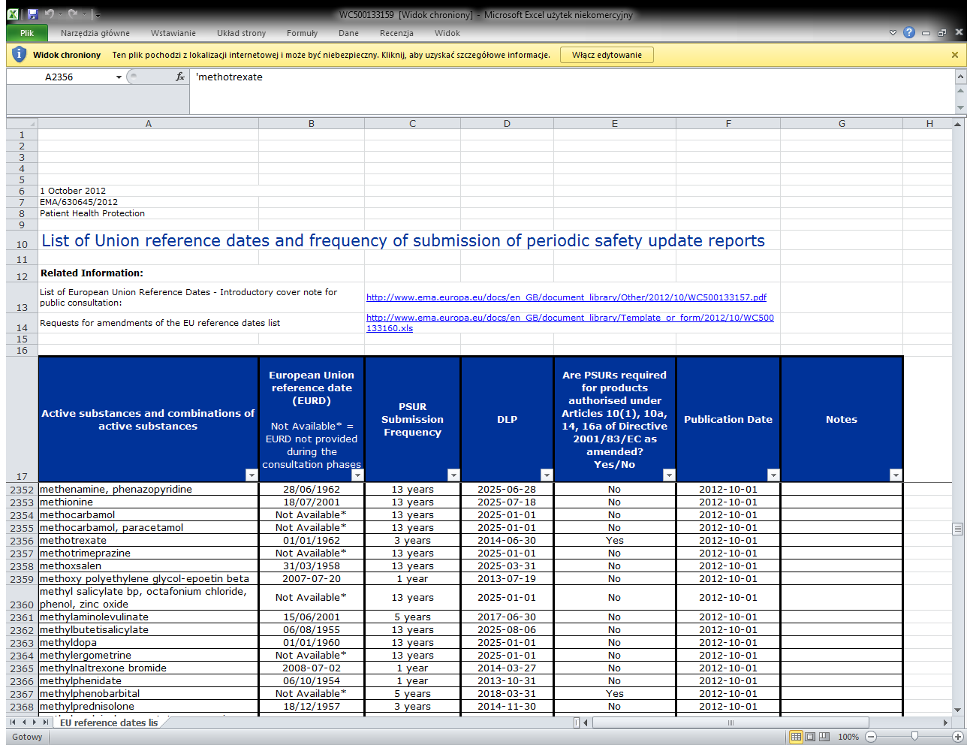
THE EURD LIST

Slide 24
PREVIOUS REGULATIONS
The Signal Detection process - detection of a previously unknown link between important side effect and medicinal product performed by the Pharmaceutical Company.
Considered discretionary, verified during audits and inspections.

Slide 25
NEW REGULATIONS:
Directive 2010/84/EC
Regulation 520/2012
Signal Detection process:
A legal obligation for Pharmaceutical Companies,
Procedure methods must be described, how the signal detection is performed,
Proces must be documented,
For all drugs signal detection procedure carried out once a month (for intensively monitored drugs - once every two weeks),
PRAC is obliged to perform this process parallely.

Slide 26
PREVIOUS REGULATIONS
Arbitration Procedures
CHMP - Committe for Human Medicinal Products, the European Medicines Agency
involved in that procedures

Slide 27
NEW REGULATIONS:
Directive 2010/84/EC
Simplification / elimination of Arbitration Procedures related to safety concerns,
Introduction of a new type of procedure - EU urgent procedure dedicated for the safety concerns of medicinal product,
Pharmacovigilance Risk Assessment Committee involved in this procedure,
The procedure has strict time frames to avoid dragging the final settlement.

Slide 28
PREVIOUS REGULATIONS:
Post-Authorisation Safety Studies (PASS)
Non-interventional studies,
not a subject to clinical trials regulations,
The registration and approval was not required,
protocols were not formally approved,
No obligation for Final Report form the study submission.

Slide 29
NEW REGULATIONS:
Directive 2010/84/EC
Post-Authorisation Safety Studies (PASS):
Post-Authorisation Efficacy Studies (PAES):
might be a condition of Marketing Authorisation,
non-interventional post-authori­sation safety studies performed by a Marketing Authorisation Holder are under obligations imposed by a National Competent Authority or the Commission in accordance with Directive 2001/83/EC and Regulation (EC) No 726/2004,
the marketing authorisation holder shall submit the study protocol, the abstract of the final study report and the final study report (all must be provided in English) except for studies to be conducted in only one Member State,
verification and approval of the studies protocol, by the Member State or the PRAC (if more than 1 study centre),
study Ammendments are under the assessment also ,
templates for the protocol, abstract and final study report – publish by the EMA.

Slide 30
NEW REGULATIONS:
Directive 2010/84/EC
Extended Responsibilities of Regulatory Authorities/Member States
Additional tasks of Agency:
To create effective system for pharmacovigilance,
To implement adequate system for collecting ADR form patients,
To encouraged to ADR reporting,
To create website dedicated to pharmacovigilance announcements,
To perform a signal detection,
To publish the Assessment Reports ,
To publish the „wording” which must be implemented to product information,
To publish the summaries of Risk Management Plan,
To assess RMP/PSUR/PASS,
To indicate a product for intensive monitoring,
To obliged MAH for PASS/PAES and BRA,
To perform any inspection,
To perform an internal regular audits of the system of pharmacovigilance - the first audit for the European Commission? Until 21 September 2013

Slide 31
GUIDLINES
Volume 9A (collecting all the practical rules and guidelines for pharmacovigilance
replaced by
Good Pharmacovigilance Practice Modules

Slide 32
GUIDANCE ON GOOD PHARMACOVIGILANCE PRACTICES (GVP)
INTRODUCTION Legal Basis and Structure of Pharmacovigilance Guidance
MODULE I Pharmacovigilance Systems and their Quality Systems
MODULE II Pharmacovigilance System Master File
MODULE III Pharmacovigilance Inspections
MODULE IV Pharmacovigilance Audits
MODULE V Risk Management Systems
MODULE VI Management and Reporting of Adverse Reactions to Medicinal Products
MODULE VII Periodic Safety Update Report
MODULE VIII Post-Authorisation Safety Studies
MODULE IX Signal Management
MODULE X Additional Monitoring
MODULE XI Public Participation in Pharmacovigilance
MODULE XII Continuous Pharmacovigilance, Ongoing Benefit-Risk Evaluation, Regulatory Action and Planning of Public Communication
MODULE XIII For references to incident management, see Module XII
MODULE XIV International Collaboration
MODULE XV Safety Communication
MODULE XVI Tools, Educational Materials and Effectiveness Measurement for Risk Minimisation
PRODUCT- AND POPULATION-SPECIFIC CONSIDERATIONS
ANNEX I DEFINITIONS
ANNEX II TERMINOLOGIES
ANNEX III TEMPLATES
ANNEX IV LIST OF INTERNATIONAL PHARMACOVIGILANCE GUIDANCE DOCUMENTS
ANNEX V LIST OF OTHER GUIDANCE DOCUMENTS

Slide 33

Thank you for your attention!

