Slide 1

Pharmacovigilance – quality assurance of pharmaceutical management in healthcare
Sten Olsson
WHO Programme Expert
Uppsala Monitoring Centre
Sweden

Slide 2
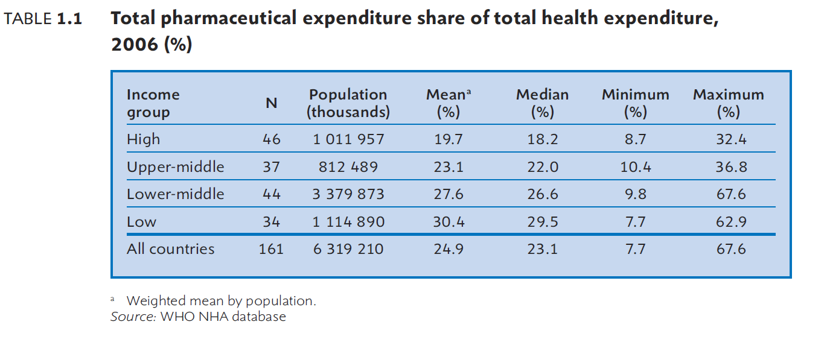
Pharmaceuticals
Among the most important health interventions in any healthcare system

Slide 3
Getting value for money
Medicines
Healthcare professionals
Competent
Good quality
Safe
Quality conscious
Healthcare delivery system
Effective, safe processes
Well managed
Efficacious
Dedicated

Slide 4
Measuring lack of performance
Medicines
Efficacious
Good quality
If suboptimal
Safe
Lack of effect
Lack of effect or toxicity
Adverse reactions

Slide 5
Measuring lack of performance
Healthcare professionals
Competent
If suboptimal
Quality conscious
Dedicated
Lack of effect
Adverse reactions
Medication errors

Slide 6
Measuring lack of performance
Healthcare delivery system
Well managed
If suboptimal
Effective, safe processes
Lack of effect
Adverse reactions
Medication errors

Slide 7
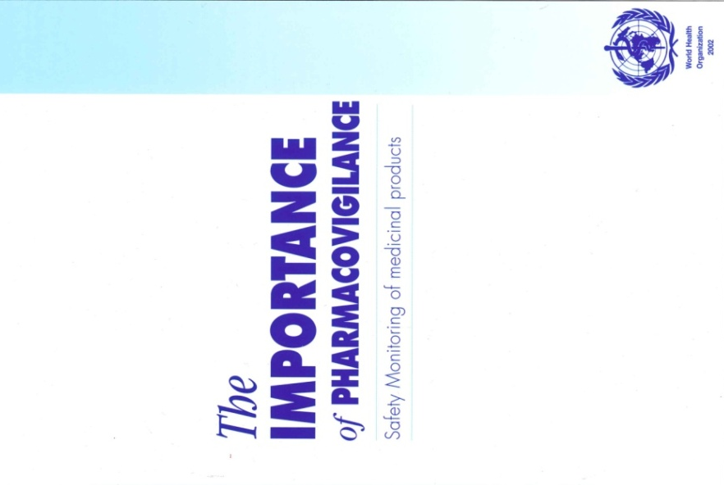
Pharmacovigilance
WHO definition
The science and activities relating to the
detection, assessment, understanding
and prevention of adverse effects or any
other possible drug-related problems
The importance of pharmacovigilance, WHO, 2002

Slide 8
Pharmacovigilance
Adverse Reactions
Properties of drug and patient
Unexpected lack of effect
Medication errors
Inadequate use
SSFFC
Inadequate quality
Failing GMP, distribution, storage etc.
Antimicrobial resistance
Inadequate use
Human factors
Failing health systems
Pharmacologic
Hypersensitivity
Other

Slide 9

We get very few reports of medicine related harm from healthcare –
does it show that we have a high-quality healthcare system?
No, not necessarily
All medicines have adverse reactions
All human beings make mistakes
All systems fail occasionally

Slide 10
European Union
5%
Hospital admissions due to ADR
5%
Hospitalized patients suffering an ADR
5th
Most common cause of death
Deaths per year
197 000
€79 billion
Cost to society /year
Ref. Report to European Commission Sept 2008

Slide 11
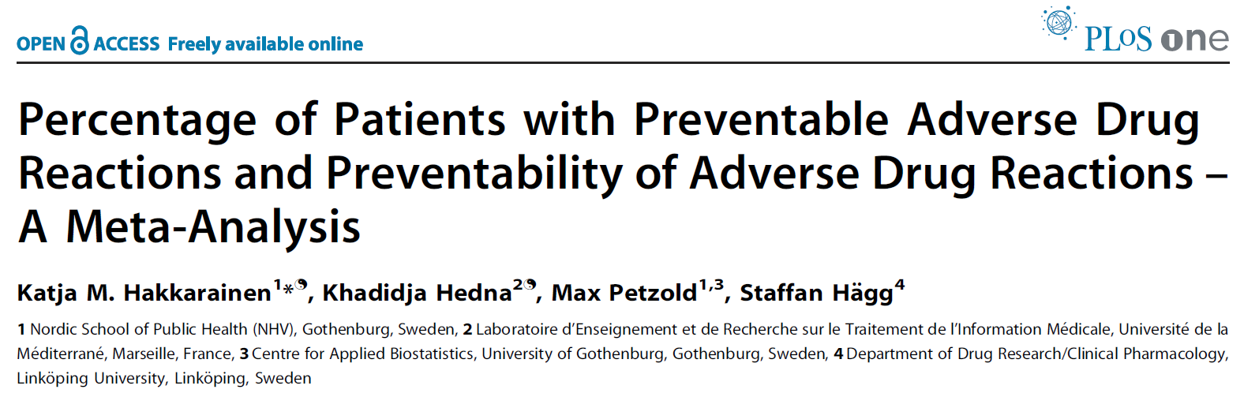
2012
2% of outpatients had preventable ADRs
52% of ADRs were preventable
1.6% of inpatients had preventable ADRs
45% of ADRs were preventable

Slide 12
If we don’t find adverse reactions, medication errors or unexpected lack of effect
It just means that we are not looking well enough
We are not vigilant
Our pharmacovigilance system is not working

Slide 13
High-quality healthcare delivery systems
Encourage reporting of ADRs, errors and unexpected lack of effect
Is non-punitive
Analyse underlying reasons (root-cause)
Learn from mistakes
Provides feed-back for continous improvement of practices
Prevent harm to future patients

Slide 14

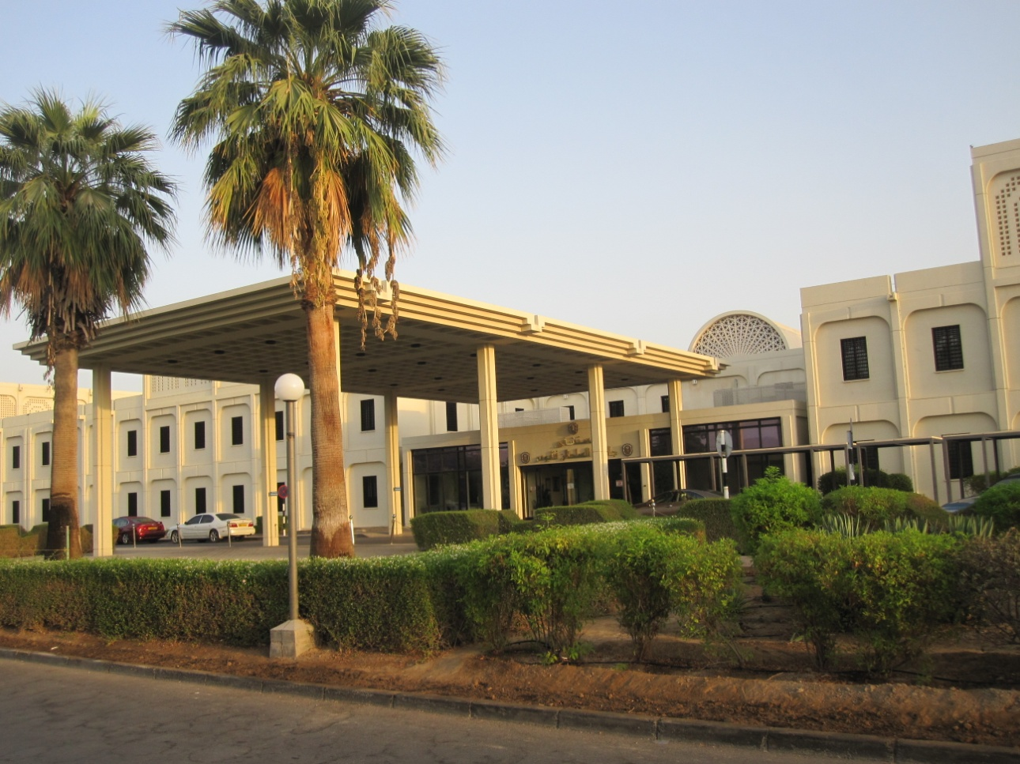
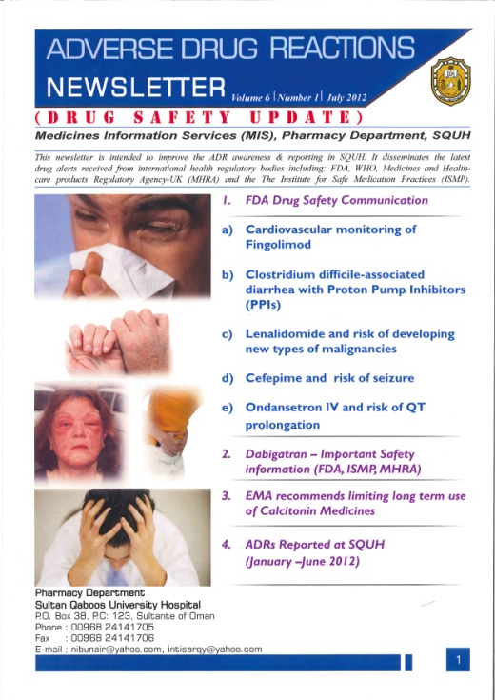
Good models exist
Sultan Qaboos University Hospital
Muscat, Oman
Aqeela Taqi Lawati & Nibu Nair

Slide 15
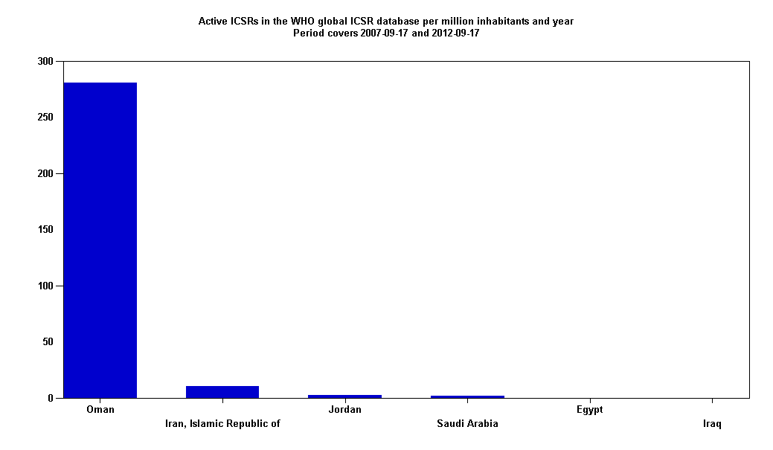
Examples from Sultanate of Oman
Number of ADR reports/million inhab/year 2007 – 2012
as reported to WHO/VigiBase™
Contribution from Sultan Qaboos University Hospital

Slide 16
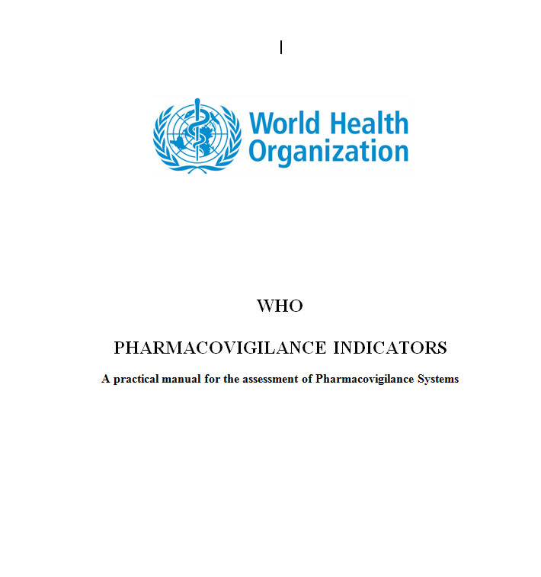
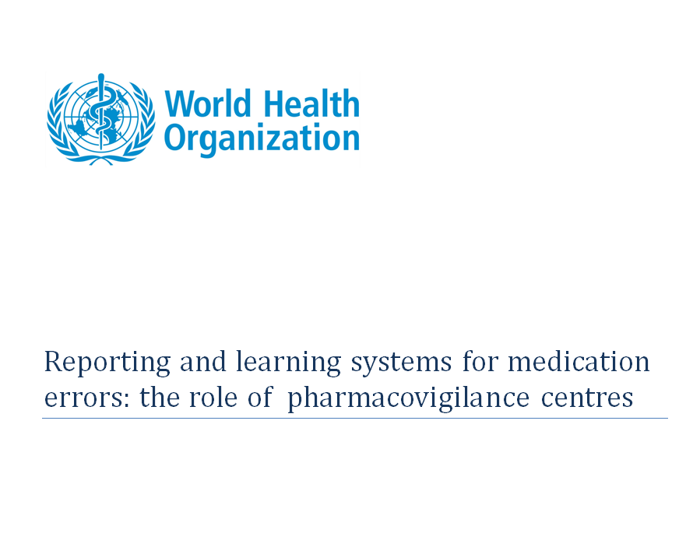
Support from WHO

Slide 17
Why pharmacovigilance indicators?
Measure status of pharmacovigilance system
Able to identify strengths, weaknesses, achievments, growth, impact
Return on investments in PV

Slide 18
Classification
Structure
  qualitative - yes/no
Process
Output/impact
Specific indicators for Public Health Programmes

Slide 19
Core structural indicators
Existance of :
A PV centre with a standard accommodation?
A statutory provision for PV? (legislation, policy)
A Drug Regulatory Authority/Agency
A regular financial provision for the PV centre?
Human resources to carry out its functions properly?
A standard ADR reporting form?
  4 subset indicators
A process in place for collection, recording and analysis of ADRs?
Is PV included in national curriculum of schools for health care professionals?
A newsletter/information bulletin/website for PV information dissemination?
A national ADR or PV advisory committee or expert committee in the setting?

Slide 20
Core process indicators (Tot 9)
Total number of ADR reports received last calender year
Total number of reports in national/local database
Percentage of total annual reports acknowledged
Percentage of reports subjected to causality assessment in the year
Percentage of national reports satisfactorily completed and submitted to NC last year
  Submitted to WHO
Percentage of reports on therapeutic ineffectiveness
Percentage of reports on medication errors
Percentage of registered MAH having functional PV system
No of active surveillance activities initiated, ongoing or completed the last 5 years

Slide 21
Core outcome/impact indicators
No of signals identified by PV centre the last 5 years
No of regulatory actions taken last year based on national data
  Label change
  Safety warning
  Medicine suspension/withdrawal/other restrictions
Number of medicine related hospital admissions/1000 admissions
No of medicine related deaths/1000 persons served by hospital
No of medicine related deaths/ 100 000 in the population
Average cost of treatment of medicine-related illness
Average duration of extension of medicine-related hospital stay
Average cost of medicine related hospitalization

Slide 22
Conclusion
Pharmacovigilance is the system by which the pharmaceutical management in any healthcare setting is being quality assured
Through pharmacovigilance indicators the appropriateness of the pharmacovigilance system can be measured
The ultimate goal is to minimize the occurrence of preventable medicine-related harm to patients

Slide 23

Thank you for your attention!
info@who-umc.org
www.who-umc.org

