Slide 1

A
PVCON Pharmacovigilance Consulting & Auditing Services
Presentation
MOIN DON
CEO & FOUNDER

Slide 2
QA & AUDITS An Important Tool For Assuring Quality In PHARMACOVIGILANCE

Slide 3

PVG INSPECTIONS
An Industry Perspective

Slide 4
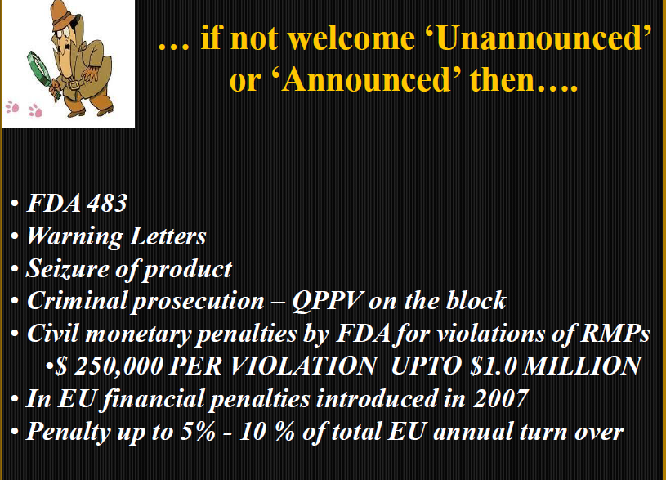

Slide 5
No Company Is Immune – The Roche Case !
In June 2012 the European Medicines Agency announced that they are working with other EU health agencies to investigate deficiencies in safety reporting at Roche. This followed an inspection by the UK regulatory body (MHRA).
The issues revolve around a Roche-sponsored patient support programme in which there appeared to be some 80,000 safety cases that may not have been evaluated to determine whether or not they should be reported as suspected adverse reactions. This included 15,161 deaths.

Slide 6
MHRA Metrics APR 2011 – MAR 2012
From Apr 2011 to Mar 2012 the MHRA conducted 81 inspections of MAHs
  UK Routine Inspections (1st Inspections)
  UK Routine Inspections (Re-inspections)
  Triggered by MHRA & CHMP
19 CRITICAL findings from 14/81 inspections conducted
219 MAJOR findings from these inspections

Slide 7
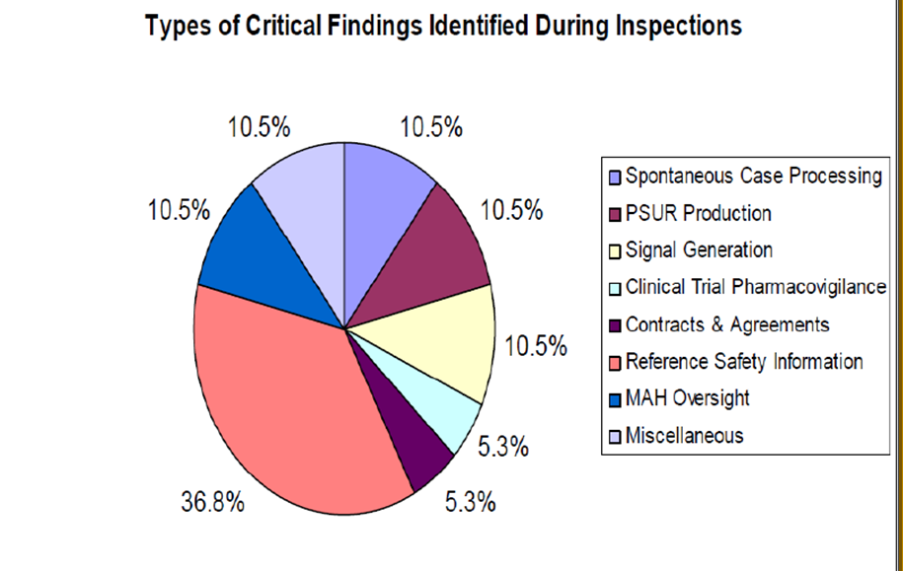
MHRA Metrics APR 2011 – MAR 2012

Slide 8
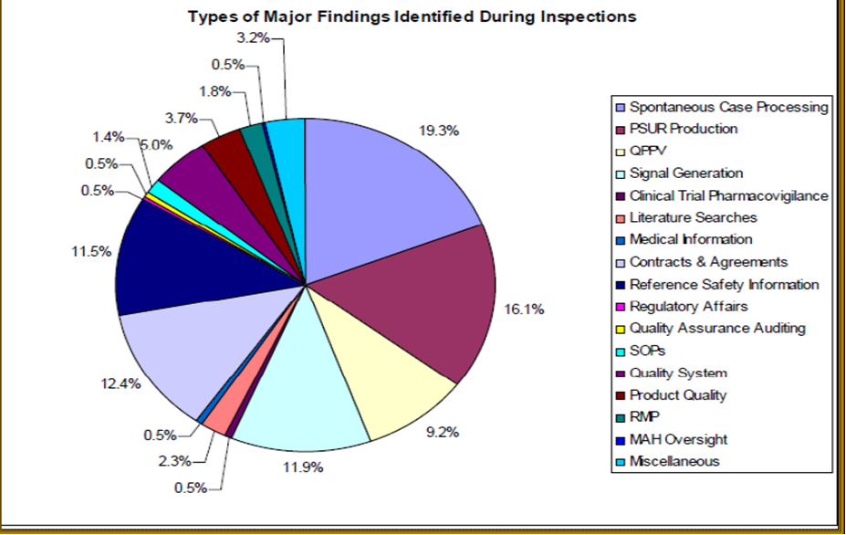
MHRA Metrics APR 2011 – MAR 2012

Slide 9
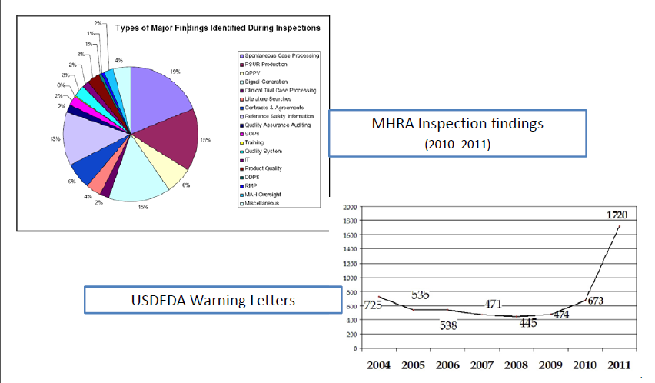
Ever Increasing Regulatory Inspections

Slide 10
Global Pharmacovigilance Inspection Trends
Past
Site based
Product safety data specific
Independence between Regulatory Authorities globally
Limited frequency
Mostly FDA Inspections
Present
Systems based with safety and /or compliance data as a potential trigger
Focused on Pharmacovigilance system –across sites / operations / products
Scope includes linkages and relationships across the company to perform Pharmacovigilance responsibilities
Increased inspection activity globally (FDA, MHRA, EMEA, etc.)
Increased collaboration across regulatory authorities globally

Slide 11
Agenda
Pharmacovigilance is a SERIOUS BUSINESS
PV Inspections
Best Practices to Face PV Inspections
Internal PV Audits – Types & Basic Principles ?
Audit Process in details ?

Slide 12
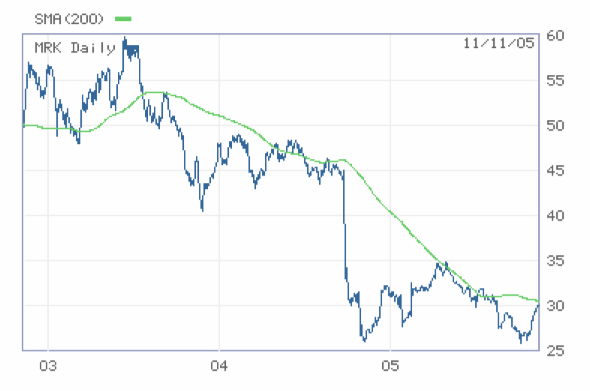
Pharmacovigilance is a SERIOUS BUSINESS
VIOXX
Tuesday, March 29, 2005
FDA drug safety scientist Dr. David Graham explains that Vioxx
may have caused as many as 55,000 deaths and 160,000 heart attacks

Slide 13
Pharmacovigilance is a SERIOUS BUSINESS
The Merck Saga
  Overnight reduction of $ 27 billion in Merck market Cap
  Loss of $2.5 billions annual sales
  Initial estimates of legal liabilities $ 50 billion
The Wyeth Story
  Fen Phen withdrawal
  Class action settlements of $ 5 billion
  Litigation reserves $ 17 billions
The Bayer Tale
  Baycol related personal injuries lawsuits
  2771 cases costing > $ 1 billion

Slide 14

1. Written Procedures
2. Training
Quality
Management
3. Quality
Assurance
4. Record
Retention

Slide 15
1
3
QUALITY ASSURANCE
4
2
WRITTEN PROCEDURES
TRAINING
RECORD RETENTION
QMS

Slide 16
Four (4) Steps For Inspection Readiness
1
3
QUALITY ASSURANCE
4
2
ROBUST PV SYSTEM
TRAINING
PV AUDIT

Slide 17
What is an Audit?
A systematic and independent examination of activities to determine whether the evaluated activities were performed according to defined requirements.*
Key Words in Definition
Systematic –organized, methodical, planned
Independent –unbiased, no conflict of interest, objective
Examination –assessment, evaluation, investigation
Defined requirements –audit criteria, regulations, procedures
*This definition compiled from an extraction of ICH and ISO definitions.

Slide 18
Why Perform an Audit?
Why Perform Pharmacovigilance System Audits?
To ensure compliance with company procedures and local / global regulatory requirements
To ensure company regulatory obligations / commitments are met
Evolving regulatory requirements
Increasing Regulatory Inspections –Internal detection of risk is essential
To identify process / quality improvements
MOST IMPORTANTLY, PHARMACOVIGILANCE AUDITS ACT AS ONE MECHANISM TO ENSURE THE SAFETY OF PATIENTS IS MAINTAINED

Slide 19
Types of Pharmacovigilance System Audits
Global Pharmacovigilance systems/processes
Company Affiliates (i.e., Country Office, Local Operating Company, Marketing Company)
Marketing (Licensing) Partners
Vendor Audits

Slide 20
Global Pharmacovigilance System Audits
Focus on central Pharmacovigilance processes
–Safety Case Processing
–Expedited Reporting
–Signal Detection / Safety Surveillance
–Aggregate Reports (e.g., PSUR, PADER, etc.)
–Literature Search
–Office of the QPPV responsibilities
Assess compliance with company procedures and global Pharmacovigilance regulations
Sample of products across therapeutic areas and a defined timeframe (vehicle to assess the system / process)

Slide 21
Affiliate Country Office Audits
Primary focus on local Pharmacovigilance responsibilities
Assess compliance with local and global company procedures and regulatory requirements (as applicable)
Evaluate the flow of safety information (from all applicable sources) from initial receipt to reporting to external parties
Involves many functional groups that impact the Pharmacovigilance system
-Pharmacovigilance -Sales
-Regulatory Affairs -Product Quality
-Medical/Clinical -Information Technology
-Marketing -Medical Information
Not just an audit of local affiliate but also of global processes to support local affiliates

Slide 22
Affiliate Country Office Audits
Topics most often covered within scope:
–Adverse event collection and processing
–Expedited reporting to regulatory authorities
–SUSAR distribution
–Product Quality Complaint handling
–Safety surveillance
–Local quality systems (including compliance monitoring)
–Regulatory functions (e.g., Aggregate reports submission, Labeling, Regulatory Authority query management, etc.)
–Contracts and Agreements (Marketing Partners, CROs, etc.)
–Medical Information
–Promotional Material
–Standard Operating Procedures (SOPs)
–Training
–Document Retention / Archive
–Electronic systems used to support the Pharmacovigilance system
–Business Continuity / Disaster Recovery

Slide 23
Pharmacovigilance Partner Audits
Marketing (Licensing) Partner Audits
Includes in-licensed and out-licensed product agreements
Focus on compliance with Marketing Partner agreement
–Ensure Pharmacovigilance roles and responsibilities are defined and performed
–Ensure appropriate exchange of safety information
Assess compliance with local and global company procedures and regulatory requirements (as applicable)
Performed independently by company, or jointly or by Consultant

Slide 24
PV System Audit Program Fundamentals
Risk Management / Audit Scheduling
Identify universe of company Pharmacovigilance systems, affiliates, and marketing partners
Identify critical risk factors / indicators* to measure each entity in the universe
–Volume of Adverse Event Cases
–Clinical Trial Activity
–Number of External Contracts / Agreements
–Previous Audit / Inspection History
–Compliance data

Slide 25
PV System Audit Program Fundamentals
Receive input from key stakeholders on proposed schedule (e.g., Head of Safety, QPPV, Regional Safety Representatives, etc.)
Communicate forward-looking schedule to global audience
*Risk factors / indicators may differ for Global Pharmacovigilance Systems, Affiliates and Marketing Partners

Slide 26
Audit Program – Process Flow
Planning and Preparation
CAPA
Follow-up & closure
Conduct
Reporting
Timeframes for each of these audit phases may vary based on company procedures, type of audit, and defined scope.

Slide 27
Audit Planning and Preparation
Pre-audit meetings to understand organization and scope of processes
Identification of system owners
Development and agreement of an audit plan defining audit objectives, scope and roles/responsibilities
Pre-audit document requests to provide framework for regulatory environment and audit conduct strategy (e.g., sampling strategy, interviews, etc.)
Development and agreement of audit agenda defining topics and personnel involved along with proposed time*
*Agendas generally require flexibility

Slide 28
Audit Conduct
Opening / Introductory Meeting to “kick off” the audit
Interviews with relevant personnel
Document reviews
Demonstration of activities (e.g., processing of an adverse event case)
Tour of facilities (e.g., work areas, file storage and archiving)
Closing / Exit meeting to discuss preliminary results
Follow-up on outstanding questions / requests

Slide 29
Audit Reporting
Audit report issued within defined timelines
–Executive Summary
–Description of Objectives and Scope of audit
–Observations
»Clear description of conditions observed
»Reference or criteria as the basis for the observation
»Quantification / Examples for context (as applicable)
»Assessment of cause and effect
»Judgment / Rating (e.g., Critical, Major, Minor, etc.) based on company … . rating scale
–Process / Quality Improvement Opportunities

Slide 30
Corrective and Preventative Action (CAPA)
Understand the observation and seek clarification as needed
Assess root cause / underlying issue
Develop CAPAs that are:
–Specific: Action resolves the issue and aims to prevent reoccurrence
–Achievable: Action that is realistic and in accordance with regulations
–Time Driven: Identify realistic timeframe for completion (based on risk)
–Accountable: Action has clear accountability defined
CAPA development is one of the most important aspects of successful audits

Slide 31
Audit Follow-up and Closure
Periodic follow-up on open CAPAs until closure (may be risk based)
Confirmation or verification of completion may be required (may be risk based)
Audit closure when applicable CAPAs have been completed
Utilize audit experience to build a culture of continuous improvement and audit / inspection readiness

Slide 32
Metrics
Aggregate analysis of audit results over a defined time period
Very effective business tool to summarize company’s risk profile and compliance status (based on audits)
Focus on most common critical deficiencies (trends) and implement global resolutions to prevent re-occurrence
Mechanism to evaluate the effectiveness of improvement initiatives

Slide 33
Preparing for Inspections –Best Practices
Anticipate an inspection
–Comply with company procedures and external regulations on an ongoing basis
–Maintain current and historical procedures/guidelines
–Ensure documentation is available, accurate and complete on an ongoing basis
–Ensure personnel training is current
–Maintain awareness of contracted functions
Have a company / site inspection plan (and routinely test it)
–Identify a core inspection team
–Maintain a key contacts list including primary and back-up contacts
–Address logistical and administrative aspects (rooms, technology, etc.)
Inspection readiness training for company personnel
Mock Inspections / Mock Interviews

Slide 34
During the Inspection –Best Practices
Relax, don’t panic!
Be polite, cooperative, confident, and professional
Escort the inspector at all times
Don’t underestimate the amount of questions and paper involved
Keep track of all questions and requests (daily notes)
Ask for clarification to questions and /or requests you do not understand
Maintain a log of all documents requested and keep copies of all documents provided to the Inspector(s)
–Indicate which documents were provided, reviewed and retained by the Inspector(s)
Clarify misunderstandings in real-time as they occur

Slide 35
During the Inspection –Best Practices - IV
DO
Take a deep breath
Listen carefully to the Inspector’s questions
Pause and formulate a proper response
Request clarification to questions not understood
Answer only what was asked
DON’T
Volunteer information
Guess the answer or speculate
Provide a clear, concise, and honest answer
Only answer questions within your job responsibilities
Provide false information
Answer questions which are outside your responsibility / expertise
Answer hypothetical questions
Make any assumptions on the question or request
Talk superfluously to fill any silence
Say that something is impossible or would never happen

Slide 36
After the Inspection –Best Practices
Exit Meeting
–Ensure appropriate company personnel are present for Exit Meeting
–Clarify misunderstandings
–Confirm reporting and response procedures
–Communicate corrective actions implemented during the inspection
Don’t wait for an inspection report to begin addressing identified non-compliances
Formulate a coordinated response with input from relevant parties
–Key system owners (Subject Matter Experts)
–Quality Assurance
–Legal
Consider impact of response on global or local operations

Slide 37
Are you Inspection Ready?
Do you have an inspection plan and contact list (and routinely test it)?
Do you have procedures in place?
  –Are they current?
  –Are they retrievable?
Do you report, process, and submit adverse events (from all potential sources) within required timelines?
Do you comply with company procedures and applicable regulations?
Are your staff qualified and trained?
Do you have quality systems in place to ensure data / process quality?
Do you know where your documentation is maintained?
Are active relationships in place with other relevant functional areas (e.g., Manufacturing, Clinical/Medical, Marketing, Sales, etc.)?

Slide 38

THANK YOU
\
Moin@pvcon.in
moindon@gmail.com
+91 9967555213

