Slide 1


Biosimilars
Basic principles of clinical development
Gonzalo Calvo
Hospìtal Clínic de Barcelona
European Association for Clinical Pharmacology and Therapeutcis (EACPT)

Slide 2
Disclossure
Member of the EMA-CHMP 2002-2011
Consultancy and academic fees from: Bayer, Almirall, Lilly, Sanofi, Merck, Astra-Zeneca, Astellas, Hospira, Pfizer, Novartis

Slide 3



Notes:
Well, that's the EU, in green the 15 courtiers forming the EU until 18 days ago. In Yellow the 10 countries joining the EU since one month ago. And Norway and Iceland, that although not officially member states of the EU actively participate in the drug regulatory process.
That's seems nice, one country, the EU, one Drug Agency, the EMEA. Full stop
But ...

Slide 4
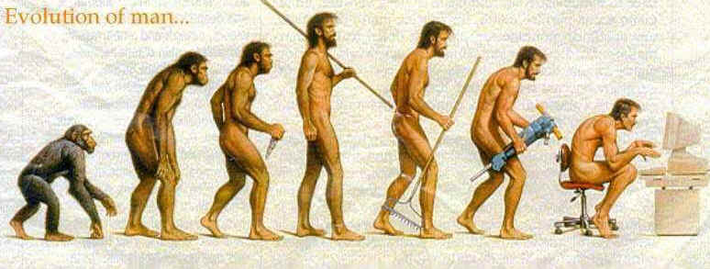

EVOLUTION OF MAN
…
IN EUROPE

Slide 5
Notes:
Well, that's the EU, in green the 15 courtiers forming the EU until 18 days ago. In Yellow the 10 countries joining the EU since one month ago. And Norway and Iceland, that although not officially member states of the EU actively participate in the drug regulatory process.
That's seems nice, one country, the EU, one Drug Agency, the EMEA. Full stop
But ...

Slide 6
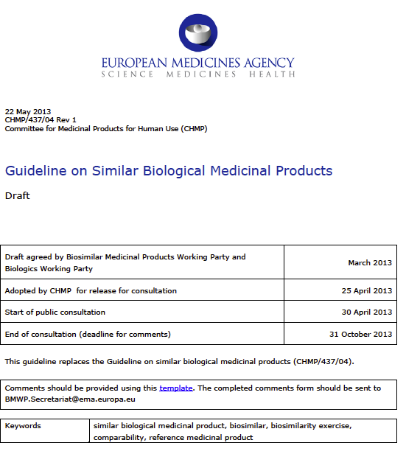
^{Directive 2001/83/E}
Defines principles
Overarching Guideline (CHMP/437/04).
“Guideline on Similar Biological Medicinal Products”
Notes:
Guideline on general principles: Clinical equivalence, Safety studies, Immunogenicity, (Pharmacovigilance)
Annexes provide specific (non)clinical data requirements

Slide 7
Biosimilar Definition
A biosimilar is a biological medicinal product that contains a version of the active substance of an already authorised original biological medicinal product (reference medicinal product). A biosimilar demonstrates similarity to the reference medicinal product in terms of quality characteristics, biological activity, safety and efficacy based on a comprehensive comparability exercise.
Key messages
Standard generic approach not appropriate
Physico-chemical comparability exercise in line with what is established in ICH Q5
Same RMP for the whole development
Biosimilar principles mainly applicable to highly purified products
Similar efficacy and safety
Full FV and RMP
Notes:
Pero qué es un biosimilar.
Esta es la definición legal, adaptada al entendimiento de las personas normales (quienes redactan las leyes nunca son normales!).
De aquí se extraen 3 conceptos básicos:
1.- Comparabilidad en términos de calidad
2.- Se van a necesitar datos clínicos de eficacia y seguridad
3.- Con todo ello se podrá llegar a la conclusión de que le medicamento iosimilar es comparable en eficacia y seguridad al innovador al que hace referencia, pero no se hace mención a la intercambiabilidad.
La intercambiabilidad es un concepto muy arraigado con los genéricos

Slide 8
Quaity
Clinical
Non-clinical
RMP
Quaity
C
GMP
Quaity
BMMP
NC
Clinical

Slide 9


Biosimilar thinking is evolving ...
How much do we need to know?
www.lucky-lions.com
Idea: C. Nick
How much „similarity“ do we need?

Slide 10
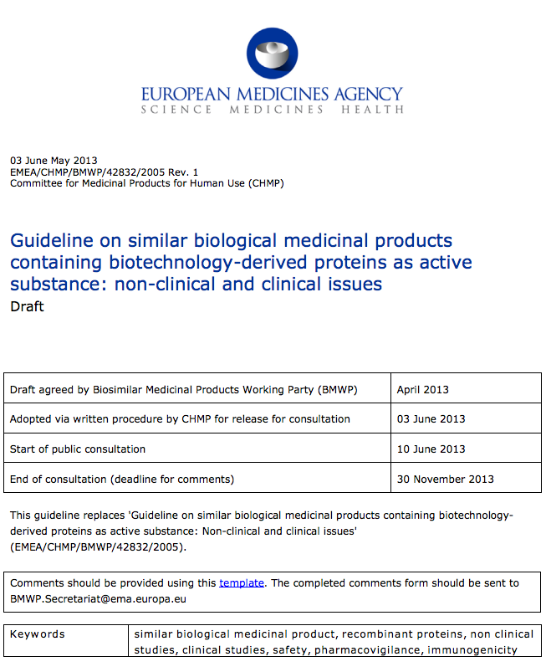
Biosimilar References
Overarching Guideline (CHMP/437/04).
“Guideline on Similar Biological Medicinal Products”
Defines principles
Biotechnology- derived proteins
Quality
General guidelines
Quality / Safety Efficacy
Non-clinical
Clinical
Notes:
Guideline on general principles: Clinical equivalence, Safety studies, Immunogenicity, (Pharmacovigilance)
Annexes provide specific (non)clinical data requirements

Slide 11
Non-Clinical
The principles of the 3Rs
Replacement
Refinement
Reduction)
Stepwise approach
In vitro studies
Determination of the need for in vivo studies
In vivo studies

Slide 12
Clinical
PK
Similar principles as for generics
Healthy subjects vs. Patients
Target-mediated clearance/immunogenicity
Same PK and decision criteria as for generics unless justified otherwise
Additional PK data during phase III studies
PD
Similar dose-response relationship as the comparator
Sensitive studies:
multiple doses
comparison within the linear ascending part of the dose-response curve
similar PK/PD
If the PD measurement can be considered to predict clinical outcome, PD studies may suffice for demonstration of biosimilarity in terms of efficacy.
ANC in G-CSF
Early viral load response for interferon alfa in HCV
Euglycaemic clamp test for insulins
RNM imaging for beta-interferon in MS

Slide 13
Clinical (cont.)
Efficacy
Clinical development of a BsMP should not primarily focussed to demonstrate the efficacy of the product itself
Main focus on demonstration of potential differences
Key aspect: STUDY SENSITIVITY
Avoid insensitive studies, even at the cost of using different endpoints from those used in the development of the InMP
Discuss with regulators on a case by case basis
Safety
Detailed evaluation of safety during the whole clinical development (PK, PD, pivotal studies)
Systematic provision of comparative safety data
Systematic comparative evaluation of immunogenicity during the clinical development.
Use of sensitive and validated assays
Blind evaluations
Sufficient follow-up
Concomitant medications
Timing of the evaluations
Lower immunogenicity is compatible with the concept of biosimilarity.
Potential effect of neutralising antibodies on efficacy should be discussed

Slide 14
Biosimilar References
Overarching Guideline (CHMP/437/04).
“Guideline on Similar Biological Medicinal Products”
Defines principles
Biotechnology- derived proteins
Quality
General guidelines
Quality / Safety Efficacy
Non-clinical
Clinical
Insulin
rGH
GCSF
Epoetin
IFN-α
LMMH
B-IFN
mAbs
Product class specific data requirements
Non-clinical
Non-clinical
Non-clinical
Non-clinical
Non-clinical
Non-clinical
Non-clinical
Non-clinical
Clinical
Clinical
Clinical
Clinical
Clinical
Clinical
Clinical
Clinical
Notes:
Guideline on general principles: Clinical equivalence, Safety studies, Immunogenicity, (Pharmacovigilance)
Annexes provide specific (non)clinical data requirements

Slide 15
rhEPOs
PK/PD
2 comparative studies vs. bridging (RI anaemia)
Correction vs. maintenance phase
SC and IV routes
Extrapolation to other indications

Slide 17
Guidance on similar medicinal products containing recombinant granulocyte-colony stimulating factor
Pharmacokinetics study : single dose cross-over studies IV and SC
Clinical Efficacy studies : Two different approaches
1/ Comparability efficacy study in the recommended clinical model
Prophylaxis of severe neutropenia after cytotoxic chemotherapy in a homogenous patient group
→ Primary endpoint : Duration of severe neutropenia
2/ Alternative model: Pharmacodynamics comparability studies in healthy volunteers
Primary endpoints : Absolute Neutrophil Count ANC_{AUC} and ANC_{Cmax}

Slide 18
Experience with Biosimilar Filgrastims
Name | Applicant | Date of Approval | Scientific Advice | Reference | Approach
Filgrastim Ratiopharm | Ratiopharm | 15-Sep-08 | 3 | Neupogen | Efficacy studies
Ratiograstim | Ratiopharm
Biograstim | CT Arzeimittel
Tevagrastim | Teva
Filgrastim Hexal | Hexal | 06-Feb-09 | 2 | Neupogen | PD studies
Zarzio | Sandoz GmbH

Slide 19
LMWHs
In vitro studies:
-FXa and anti-FIIa
In vivo studies:
in vivo pharmacodynamic mode for the evaluation of anti-FXa, and anti-FIIa activity and of release of tissue factor pathway inhibitor.
In accordance with the intended clinical indication(s), either a suitable animal venous or an arterial thrombosis model.
19

Slide 20
LMWHs (cont.)
Clinical trials are needed to demonstrate the similarity in terms of efficacy and safety compared to the reference product
Comparative PD in a randomized, single dose, two way crossover study in healthy volunteers using subcutaneous administration
Therapeutic equivalence should in general be demonstrated in at least one adequately powered, randomised, double-blind, parallel group clinical trial in the most sensitive model:
Preferably the trial should be conducted in major orthopaedic surgery such as hip surgery. Patients with hip fracture should be well represented
Primary endpoint: total DVT possible
RMP should include known rare serious adverse events for LMWH such as Heparin-induced Thrombocytopenia Type II (HIT Type II).
20

Slide 21
Insulin and insulin analogues
Pre-Clinical Trials:
comparative in nature and designed to detect differences in the response between the biosimilar candidate and the reference drug
comparative bioassays of affinity and intrinsic activity of insulin and IGF-1 receptors
Clinical Trials:
pharmacokinetic profile → comparative pharmacokinetics with AUC and Cmax as primary endpoints
pharmacodynamic profile → Clamp Study
euglycaemic, hyperinsulinaemic clamp study.
primary endpoints: GIRAUC and GIRmax; Secondary endpoints: TGIRmax and TGIR50%
clinical efficacy → not required: efficacy demonstrated in clamp study

Slide 22
Insulin and insulin analogues (cont.
Safety Clinical Trials:
immunogenicity is the key evaluation
must be evaluated in a reasonable number of type-1 diabetes patients, for a 12 months minimal duration, with a comparative phase of at least 6 months
Pharmacovigilance:
Risk Management Plan (RMP) to be presented during the application
according to European guidelines
the Plan must consider the known and potential risks of the reference product

Slide 23
Revision of the Guidelines
Risk-based approach for non-clinical testing
Sensitivity of the clamp study for detection of potential differences in the duration of action or otheraspects related to long-term acting insulins
Study population (patients with type 1 diabetes versus healthy volunteers)
Desing of clamp studies

Slide 24
INTERFERON BETA
PD fingerprint
m (2’-5’)oligo-adenylate-synthetase activity,
neopterin,
β2-microgloblin,
interleukin 10,
TNF-related apoptosis inducing ligand (TRAIL)
myxovirus resistance protein A (MxA).
NON CLINICAL
In vitro
In vivo: no data needed
CLINICAL
PK healthy vol
PD (as part of the PK study)
Therapeutic equivalence should be demonstrated
RRMS
No relapse rate
MRI imaging count
3-arm 12-month study

Slide 25
mAbs
NON CLINICAL –STEPPED APPROACH
Step 1. In vitro studies
Binding to target antigen
Binding to isoforms of Fc gamma receptors
Fac and Fc associated functions
Comparative setting
Sensitive models to detect concentration-related activity
Step 2. Need for in vivo studies
Presence of attributes (or quantitatively differences in the amount of attributes)
Different formulations
If step 1 satisfactory and factors above not presence. NO IN VIVO ANIMAL DATA
Step 3. In vivo studies
3Rs principles approach (Replacement, Refinement, Reduction)
Optimise study design to maximize of PK/PD and safety controlled information
Safety studies in non-human primates not recommended

Slide 26
mAbs
CLINICAL –STEPPED APPROACH (PK, PD, EFFICACY)
Step 1.
PK
Healthy volunteers as a sensitive population
Dose selection
Influence of target dependant clearance in number and design of studies
Possible time-dependent PK
PD
PD markers as support of to establish comparability
PD markers as pivotal proof of comparability
Clear dose-response
Relevance of PD for the efficacy
Step 2. Clinical efficacy
Comparable effect, not clinical benefit
Homogeneous and sensitive population
Primary endpoints able to capture treatment differences (ORR, ORR at predefined time,
Sensitive dose, not compromising safety and immunogenicity

Slide 27
mAbs
CLINICAL –SAFETY
Prospective collection during the entire clinical development
Standardise definition of safety endpoints of interest (mimicking innovator definitions)
If pivotal evidence of comparability is PD, comparative safetyt and immunogenicity data normally required before MA
Safety data from repeated exposure before MA
Assessment of immunogenicity
Higher immunogenicity
Lower immunogenicity

Slide 28
Pharmacovigilance and RMP
Compulsory PhV and RMP as for innovator products
Identified and potential risks from the innovator must be considered
Possible newly identified issues (to be applied to the innovator as well)
Immunogenicity should always be included as a risk to be monitored and further characterised
Traceability is a key aspect in the assessment of post-marketing safety assessment

Slide 29
Immunogenicity
Immunogenicity of a biosimilar must systematically be investigated,
The predictive value of non-clinical studies for the evaluation of immunogenicity in human is low
the comparison of the antibody response of the biosimilar to the reference product in an animal model may be part of the comparability exercise, but still clinical study will be required
Immunogenicity may have to be assessed individually for each indication / patient population,

Slide 30
Monoclonal antibodies as a paradigm
Age, indication, dose, different sampling schedule, chance?

Slide 31
Immunogenicity
Immunogenicity of a biosimilar must systematically be investigated,
The predictive value of non-clinical studies for the evaluation of immunogenicity in human is low
the comparison of the antibody response of the biosimilar to the reference product in an animal model may be part of the comparability exercise, but still clinical study will be required
Immunogenicity may have to be assessed individually for each indication / patient population,
Optimal antibody-assay strategy (detection and characterisation) is needed
assays to be validated throughout product development
screening assay highly sensitive, specific, precise, reproducible and robust
an assay for “neutralising antibodies” should be available
Immunogenicity is to be addressed in the Risk Management Plan (RMP)

Slide 32
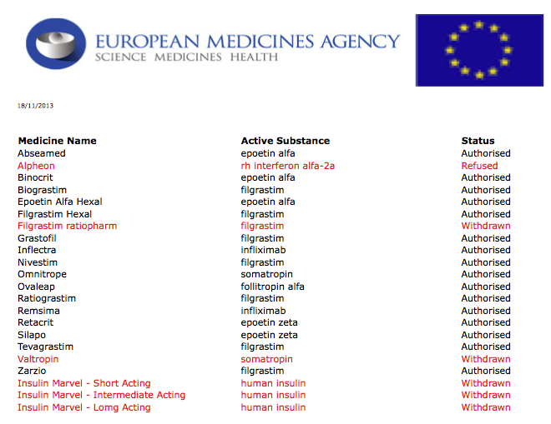

Slide 33
In summary …
The legal framework in the EU is relatively clear
In general, PD or therapeutic equivalence in the most sensitive indication is the rule
Clinical immunogenicity data must be provided pre-marketing
A RMP should be provided as for an innovator product
Tracebaility of prescriptions and dispensing is key for safety monitoring
Rapidly evolving field

Slide 34

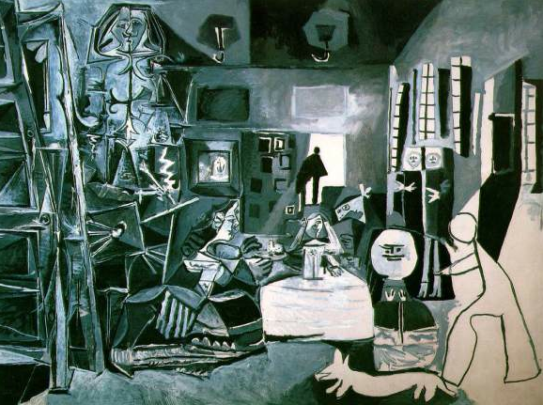

Slide 35
Controversies
Controversies
Demonstration of therapeutic equivalence
PD vs. clinical endpoints
Study population
Duration of the study
Extrapolation of indications
B/R demonstrated for the RMP
Full PK and PD characterisation
Similar efficacy in all indications?
Interchangeability and substitution
Traceability
Immunogenicity
Suitability of a fully reliable RMP and PhV activities

